Slide 1
Obstacle avoidance based on Reach Sets
Alojz Gomola
12th July 2019, Porto
Defense Presentation of Doctoral Thesis in Applied Mathematics
Notes:
Speech:
Dear (Lady, and Gentlemen), my name is Alojz Gomola and for today I am going to defend thesis with title:
“Obstacle avoidance based on Reach Sets”,
Which was supervised by
Joao Sousa from LSTS, and
Fernando Lobo Pereira from FEUP,
Your Notes:

Slide 2
Overview
Sense & Avoid introduction:
Context of SAA
Actors
Reactive Obstacle Avoidance
Problems in Detect & Avoid:
Explained as a story
Incremental problem definition
Related work:
Movement Automaton
Surveillance
Navigation
Reach set estimation
Proposed framework:
Overview
Avoidance Run
UTM Implementation
Rule Engine
Simulations:
Test Plan
Obstacle avoidance
Weather avoidance
Rules of the Air
Cooperative vs. Noncooperative
Conclusion
Notes:
Speech:
Let me start with short overview,
First there will be an introduction into Detect and Avoid,
Then I will outline problems which we approached,
The brief introduction of “Related work and used concepts”
Is necessary before we go trough “Proposed framework”
After that the test cases and performance will be shown
Your Notes:

Slide 3
Sense & Avoid Introduction: Airspace classification UAS Traffic Management Terminology Reactive Avoidance
Notes:
Speech:
The main goal of the thesis was to develop a framework,
for an UAS to be able to fly in “non-segregated air space”,
Let's start with short introduction
Note: All Airspace related rules and constraints can be found in chapter 2. This section is only a short introduction.
Your Notes:

Slide 4
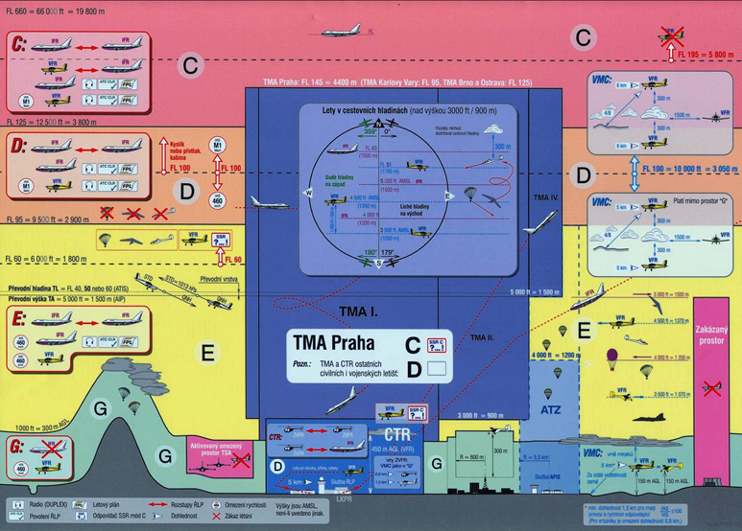
Context of SAA: Airspace classification (2.2)
Notes:
Speech:
There is airspace vertical classification based on altitude,
Different rules and authorities applies on different
“flight levels”,
“C class airspace” is where passenger planes operates
Note: There is slight difference between countries, this example is valid for Czech/Slovak Republic.
Your Notes:

Slide 5
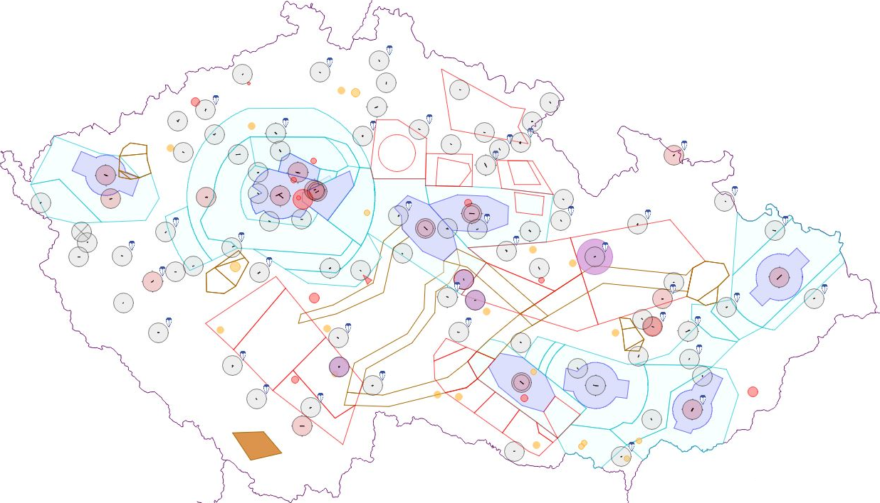
Context of SAA: Airspace restrictions (2.3)
Airport
Control zone
Temporary area
*Example of air traffic constraints is taken from Czech national air traffic control portal (http://aisview.rlp.cz/)
Notes:
Speech:
The same goes for horizontal plane restrictions,
Airspace authority can prohibit operations in specific area,
For example the “orange rectangle” was marked as
”Restricted Area”,
Due the “Military exercise”.
Your Notes:

Slide 6
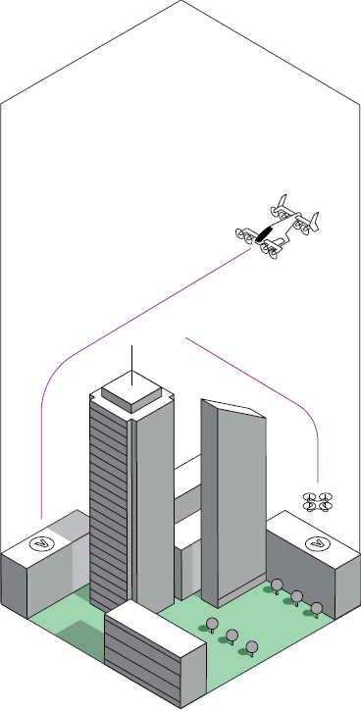
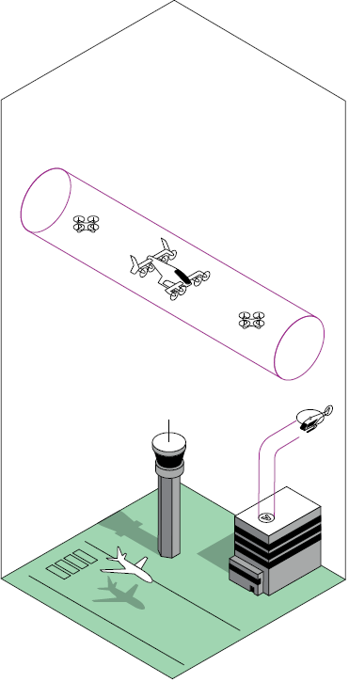
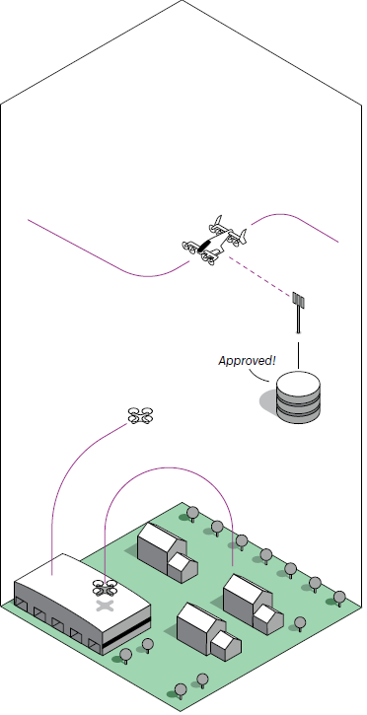
Context of SAA: UAS Traffic Management (UTM) (2.5)
a
Notes:
Speech:
As for the manned aviation there is ATM, the similar concept is applied for UAS, The UAS Traffic Management system is established by “EASA” in EU,
You can see examples of UAS operations:
1. Free flight,
2. Corridor like navigation,
3. Path enforced by authority,
The latest has been implemented in our work
Your Notes:

Slide 7
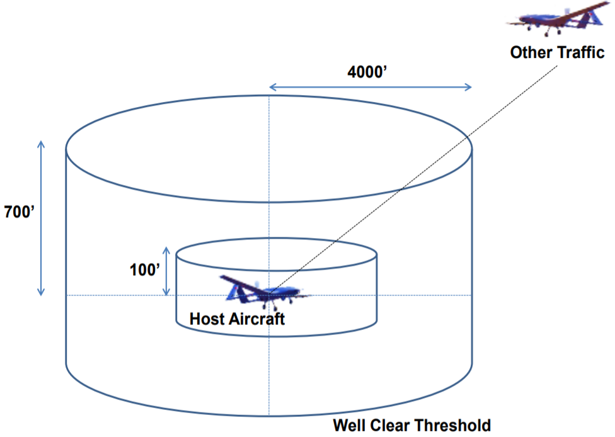
Context of SAA: Goal in controlled airspace: Remain well clear
Notes:
Speech:
The aviation is using “Well clear distance”
The bigger barrel is called “Well clear margin”
Which is considered as “warning zone”
No plane should enter that zone
The smaller barrel is called “near miss margin”,
Entrance is considered as a “serious incident”
Your Notes:

Slide 8

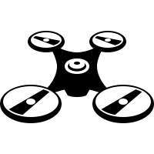


Context of SAA: Actors introduction
UAS
Adversary
Intruder
Static obstacle
Notes:
Speech:
The UAS is interacting with obstacles:
- Static not changing position with time, like buildings,
- Moving which are not trying to harm us – Intruders,
- Moving which are trying to harm us – adversaries,
Note: The work does not consider “adversaries”,
Your Notes:

Slide 9
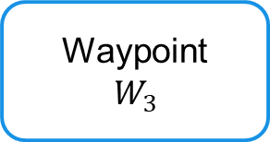


Context of SAA: Reactive Sense & Avoid
Field of Vision
(FOV)
Obstacle
Follow avoidance path
Waypoint
$$W_{1}$$
>Calculated Avoidance Path<
Reactive obstacle avoidance
Obstacle detection
Waypoint
$$W_{3}$$
Waypoint
$$W_{2}$$
Planned path
Notes:
Speech:
UAS is tasked to fly a mission given as an ordered list of
“Waypoints”, the UAS is solving:
1. Reactive Avoidance – immediate threat,
2. Preemptive Avoidance – long term threat,
The example shows implementation of both,
1. UAS spots an obstacle
2. The long term path is not feasible
3. Newly calculated avoidance path is taken
Your Notes:

Slide 10
Problems in Detect & Avoid: Explained as a story Incremental problem definition
Notes:
Speech:
Now lets define the problem which is going to be solved,
Your Notes:

Slide 11
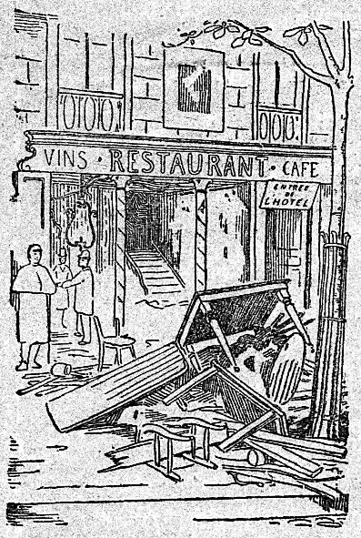

<-
<-
<-
How this gentleman
gets
into the Fine Restaurant
[1]https://commons.wikimedia.org/wiki/File:Le_restaurant_V%C3%A9ry_-_ext.png
[2]https://commons.wikimedia.org/wiki/File:A_gentleman,_walking_towards_the_left_and_drawing_his_sword_from_the_sheath,_wearing_a_plumed_hat_and_boots_with_spurs_MET_DP829192.jpg
Notes:
Speech:
The obstacle avoidance can be taken as a “trip to a pub”,
Lets help this gentleman get into the fine restaurant,
Your Notes:

Slide 12
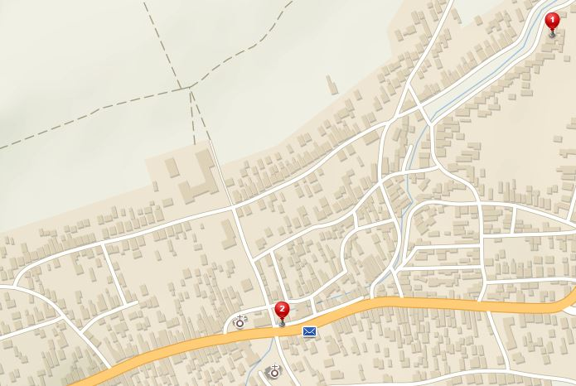
How to get to the fine restaurant ?
Östlichesburg
~ 1269 AD
Home
Restaurant
Notes:
Speech:
We have a simple mission get from the home (red),
To the “Fine restaurant” (blue),
Your Notes:

Slide 13
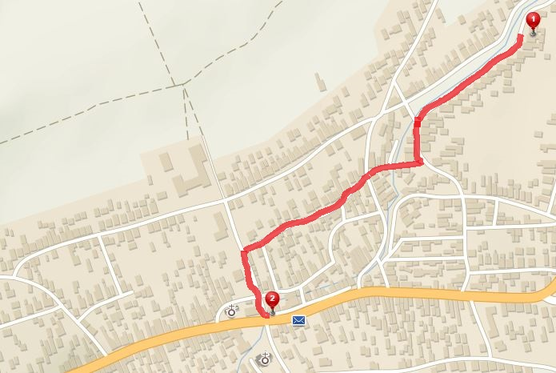
No problem, I know a map of my surroundings
[P1] Path planning problem:
1. Get MAP
2. PLAN then EXECUTE the PATH
Path to restaurant
Notes:
Speech:
First is “Path planning problem”, we know everything,
We just need stick to the plan.
Your Notes:

Slide 14
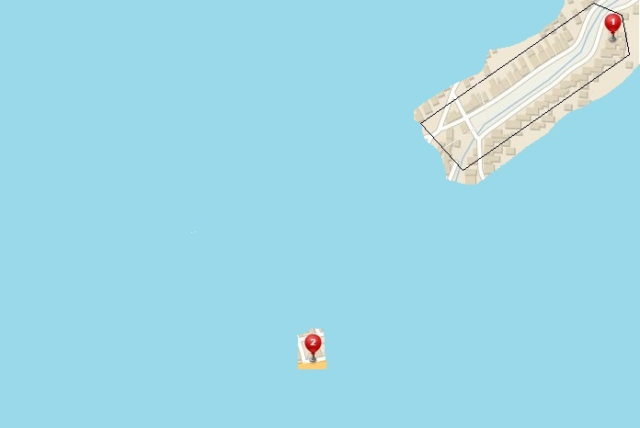
Forget your map, know the restaurant location
[P2] Evolving world:
1. Obtaining knowledge over time
2. Continous Decision Making
My Position
Field of Vision
GOAL
Notes:
Speech:
I need to use my eyes, “Sensor system” to scan my surroundings,
I am forced to do “Continuous decision making” and adapt.
I am limited by my field of the vision (black box)
Your Notes:
12th July 2019, Porto
Obstacle Avoidance Framework based on Reach Sets
Thesis presentation
113

Slide 15
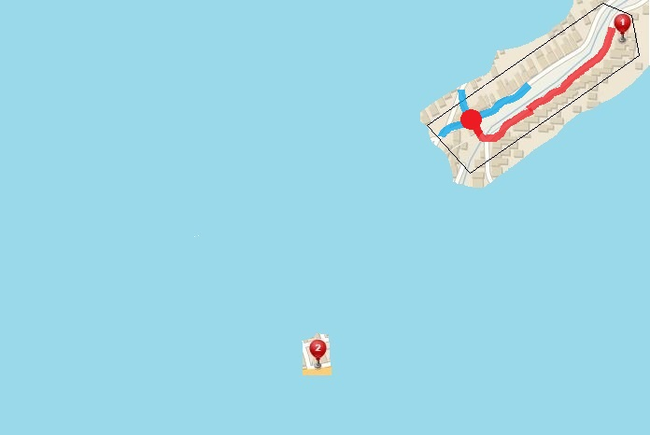
I get to the first intersection, now what ?
Decision Point:
Way 3
Way 2
Way 1
Decision point
Passed trajectory
GOAL
Apply COST Function
In
Decisions
Notes:
Speech:
Because I am lazy I am changing my path only on
“Decision points” (red circle),
I look around and I see three possible ways,
Your Notes:
12th July 2019, Porto
Obstacle Avoidance Framework based on Reach Sets
Thesis presentation
14

Slide 16
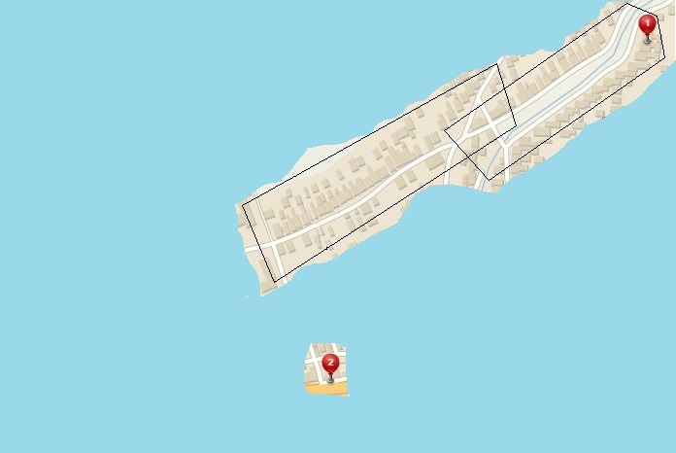
Look around, get know to your surroundings
This PATH can get me Closer
GOAL
Notes:
Speech:
I choose the most promising path according to
“Cost function”,
I will continue along the way
Your Notes:

Slide 17
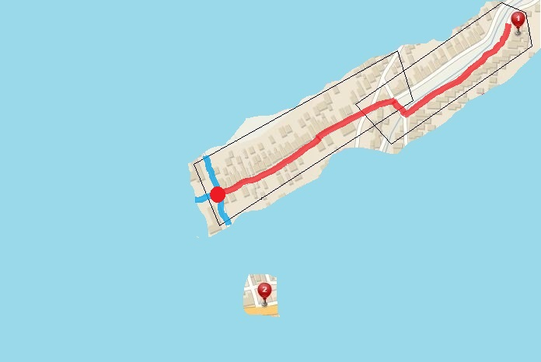
Walk a little more, get closer to the Restaurant
Rinse and repeat
Way 3
Passed trajectory
Way 2
Decision point
Way 1
GOAL
Notes:
Speech:
I reached the next decision point,
I look around and I see three possible ways,
Your Notes:

Slide 18
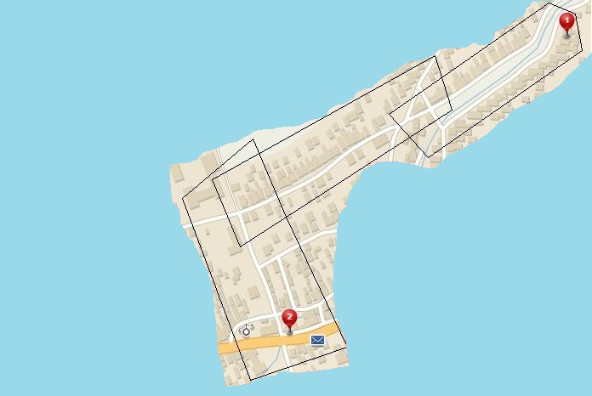
Now Gentleman can see the Restaurant
GET to the Restaurant
GOAL
I can see the way
to the Restaurant
Notes:
Speech:
I choose to pick the path that will decrease my cost,
I do next “sensor scan”,
I can see the restaurant,
Your Notes:

Slide 19
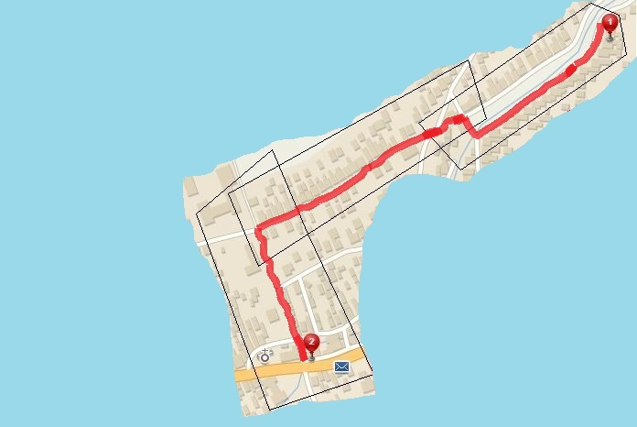
Enjoy a Pint
[P2] Evolving world:
SEMI-Optimal navigation to GOAL
Less optimal than [1]
Your destination is at the right side of the road
Notes:
Speech:
The “Evolving world” leads to “semi-optimal” problem solution,
Where the path between “decisions points” is “optimal”,
According to the “cost function”
This is getting closer to real world navigation where we are limited by our “field of vision”.
Your Notes:

Slide 20
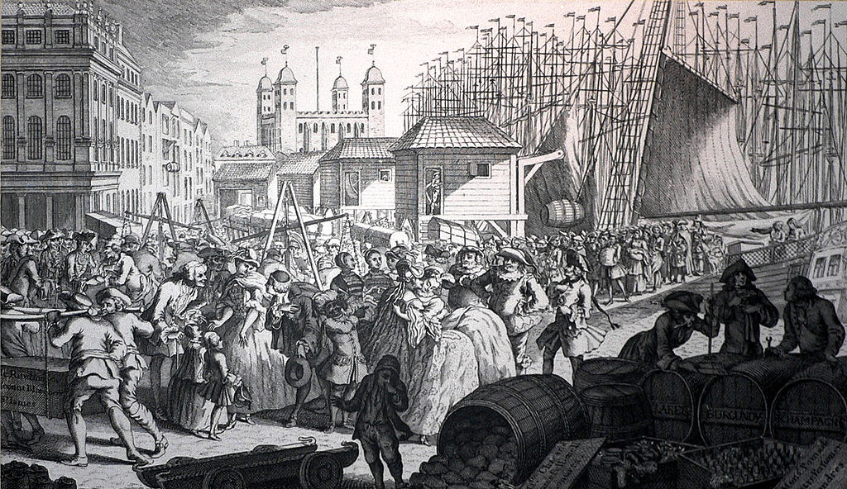

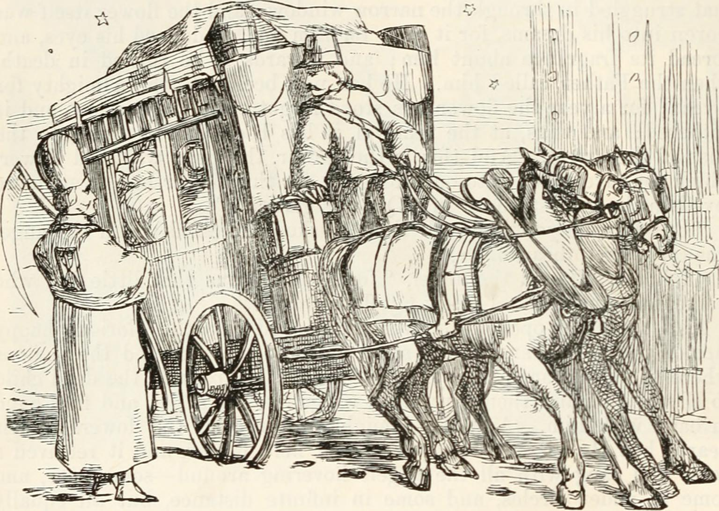
You are NOT alone on the streets !
[P3] Intruder:
You need to avoid:
Carriages and Other people
You can hurt others !
[P3] Intruder:
Reactive obstacle avoidance
Ingredients:
Intruder Position
Intruder Velocity
Own position and velocity
Notes:
Speech:
There are others around us, lets call them “intruders”,
They are moving, they can harm us, but don’t want to,
We know their position, heading and body mass,
For sure, we want to avoid them,
Your Notes:

Slide 21
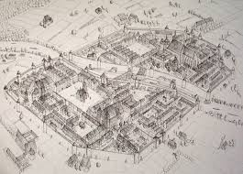
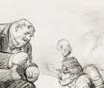
Multiple source of information – Data Fusion
[P3] Data fusion:
So much Information …
So many Whispers …
Need Validation …
Much Verification …
[P3] Data Fusion:
Decisions under uncertainty
Determine what is truth
Consider all information
Rank your sources worth
Notes:
Speech:
You have various sources of data,
The map is outdated, the pub was moved,
You need to determine what is the true,
You need to fuse data in “Data fusion”,
Your Notes:

Slide 22
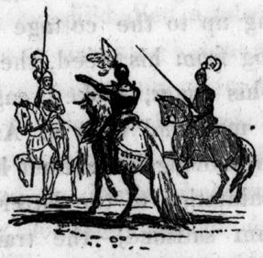
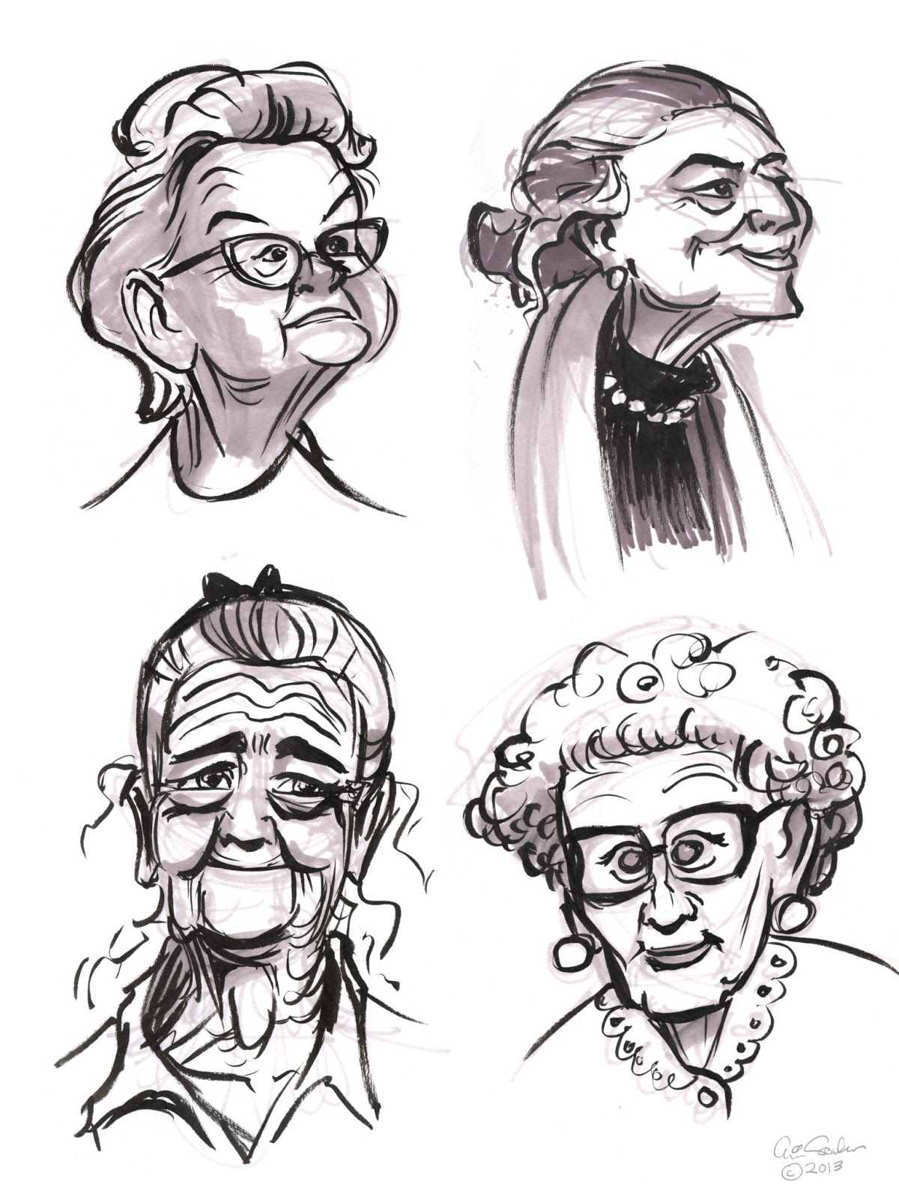
Vigilantes & Grannies – Static restriction areas
[P3] Static restrictions:
Vigilantes will kill you …
Grannies will tell your grandmother ….
[P3] Static restrictions:
You can break it, but you
will pay
TERRIBLE PRICE !
Try to avoid all restricted areas
Notes:
Speech:
When we managed to avoid intruders, the problem is,
Still standing folk, or “static restrictions”,
There are vigilantes they will fine you,
They are considered “hard constraints”,
There are grannies who are just going to tell on you,
They are considered “soft constraints”,
The parallel are the airspace restrictions,
Your Notes:

Slide 23
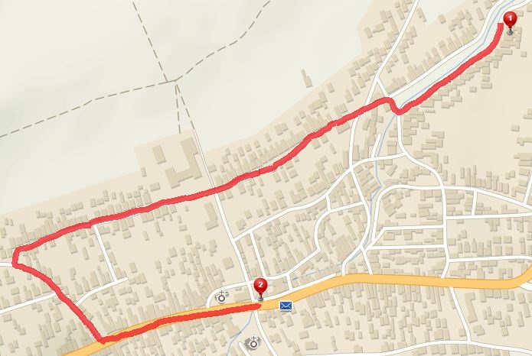
Try to avoid static restrictions areas !
[5] Static restrictions:
Avoid them all !
Vigilante
Grannies
Notes:
Speech:
Try to avoid “static restrictions”, take long detour (red line)
Note:
The path is semi-optimal (continuous-decision making) with given restrictions
Your Notes:

Slide 24


How about weather ?
[P4] Weather:
Östlichesburg winter very harsh,
On the other hand,
Östlichesburg summer even Harsher
[P4] Weather:
Harsh Weather Avoid NOW !
Maybe you will need to break some restrictions
Notes:
Speech:
We try to avoid hash weather conditions, which acts like:
1. “Moving constraint”, or,
2. “Static constraint”,
Some prioritization needs to be implemented in our,
“Data fusion”,
Your Notes:

Slide 25
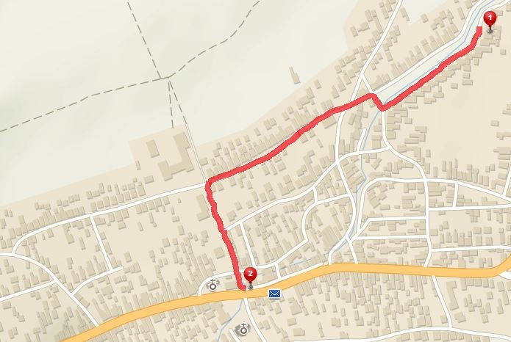
Rather get caught, than catching cold …
[P4] Weather:
You will avoid Snowstorm,
But you will answer to Grandmother call …
Snowstorm
I will explain somehow…
Vigilante
Heatwave
Grannies
Notes:
Speech:
The prioritization of “constraints” is like follow:
Rather get yelled by granny than catching a cold
Note:
The red path is crossing grannies territory, breaking “soft static constraint”

Slide 26
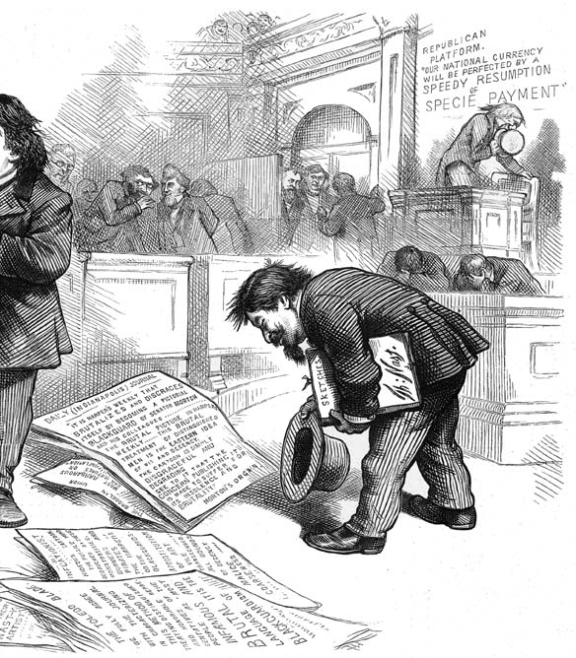
Stick to the rules !
[P5] Rules:
Obey rules while walking
[P5] Rules:
Stick to Written and unwritten rules …
Necessity
for integration into traffic,
society,
air space
Notes:
Speech:
It is necessary to obey the authority, in traffic, society,
Especially in “Airspace”,
The different airspaces implements different rules
Your Notes:

Slide 27
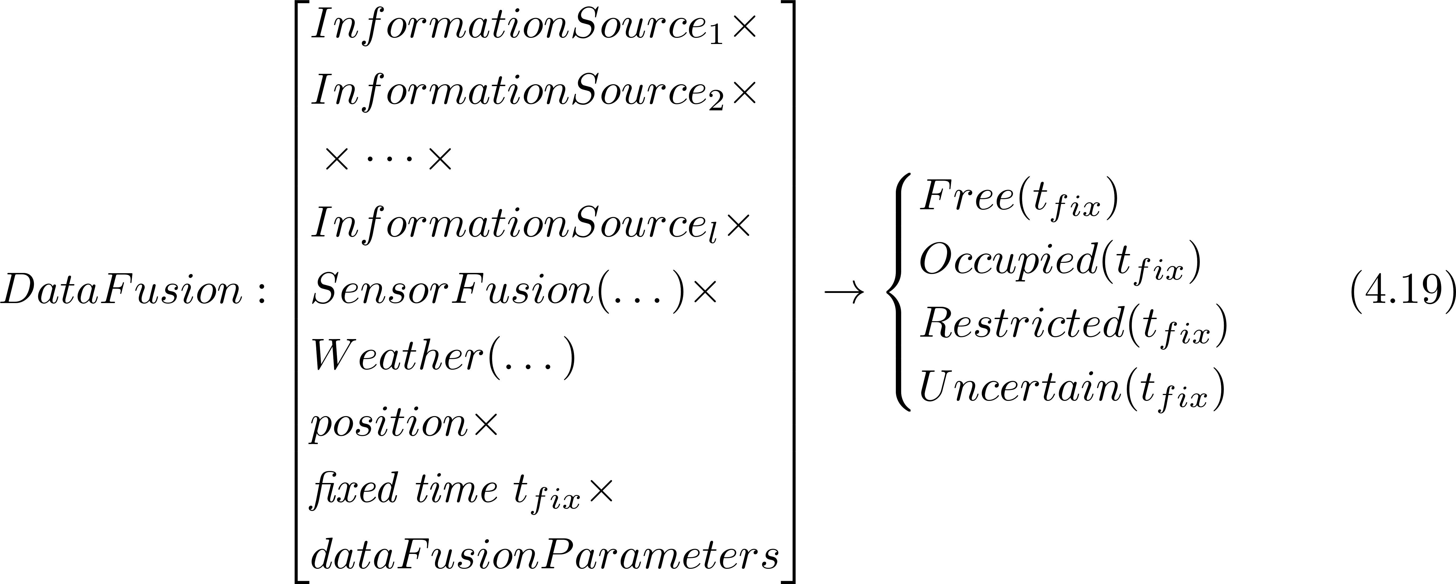
Formal problem specification 1/2
The UAS is operating in space classified into four distinctive subsets:
The space classification is coming from data fusion procedure:
Notes:
Speech:
Let say that UAS classifies for every time operational 3D space into four categories:
1. Free -where it can move
2. Occupied – where crash happens,
3. Uncertain – out of our knowledge
4. Restricted – other threat,
The space classification (4.10) is result of “Data fusion” (4.19)
Note:
The data fusion will be discussed later,
Your Notes:

Slide 28
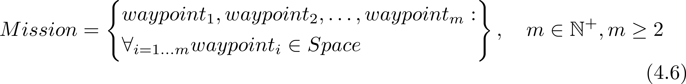
Formal problem specification 2/2
UAS will fly a Mission given as ordered set of waypoints:
The goal is to have path satisfying:
Under the assumptions:
Filtered sensor reading are available.
There are no moving obstacles (intruders) [Relaxed P3]
The movement takes place in unrestricted airspace [Relaxed P5]
The mission consist of a set of reachable waypoints
The UAS is moving with constant velocity [Relaxed P5]
Notes:
Speech:
The UAS is flying a mission given as a set of ordered waypoints (4.6),
The goal is to keep the distance to any occupied space greater than some margin (4.21),
Under following assumption:
1. Sensor readings are clear,
2. There are no intruder for now,
3. The airspace is unrestricted,
4. The waypoints are reachable,
5. UAS constant speed,
Note:
Some assumptions are relaxed over time,
Your Notes:

Slide 29
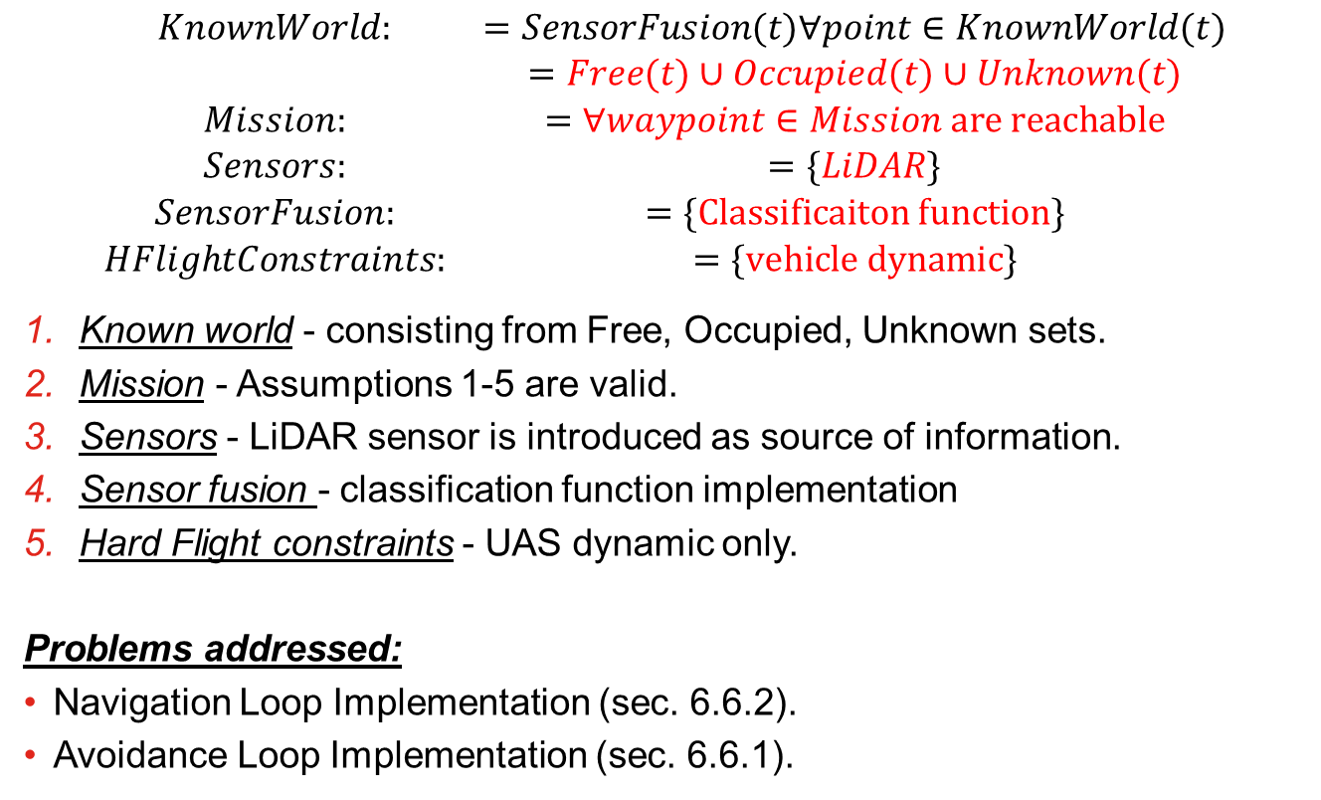
Incremental problem definition: [P1] Basic Avoidance
$$\begin{matrix}KnownWorld: & =SensorFusion(t)∀point∈KnownWorld(t) \\ & =Free(t)∪Occupied(t)∪Unknown(t) \\ Mission: & =∀waypoint∈Mission are reachable \\ Sensors: & =\{LiDAR\} \\ SensorFusion: & =\{Classificaiton function\} \\ HFlightConstraints: & =\{vehicle dynamic\}\end{matrix}$$
Known world - consisting from Free, Occupied, Unknown sets.
Mission - Assumptions 1-5 are valid.
Sensors - LiDAR sensor is introduced as source of information.
Sensor fusion - classification function implementation
Hard Flight constraints - UAS dynamic only.
Problems addressed:
Navigation Loop Implementation (sec. 6.6.2).
Avoidance Loop Implementation (sec. 6.6.1).
Notes:
Speech:
The “Basic avoidance problem” is like follow:
1.UAS is equipped with LiDAR sensor, flies over open space with static obstacles only,
2.The “Restricted space” is out of question,
3.There are only “vehicle dynamic constraints”
The LiDAR stands for Light Detection And Ranging it’s a laser based sensor which can scan surroundings as a point cloud.
Your Notes:

Slide 30
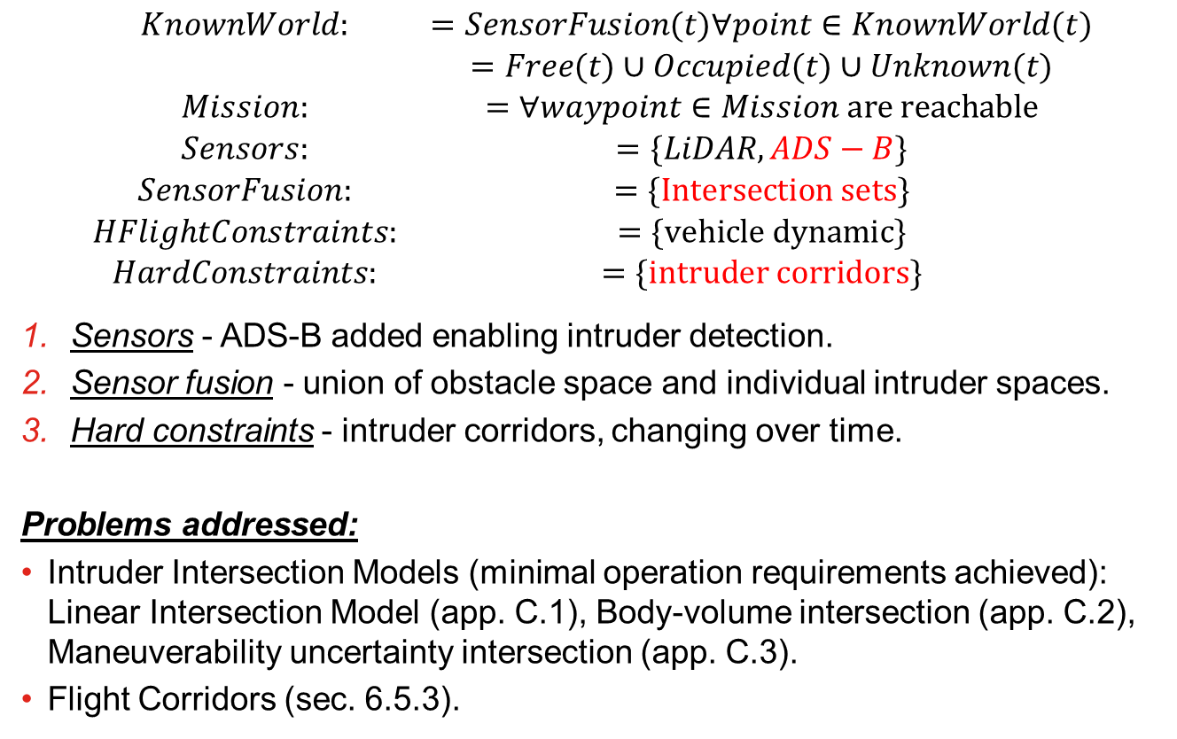
Incremental problem definition: [P2] Intruders Introduction
$$\begin{matrix}KnownWorld: & =SensorFusion(t)∀point∈KnownWorld(t) \\ & =Free(t)∪Occupied(t)∪Unknown(t) \\ Mission: & =∀waypoint∈Mission are reachable \\ Sensors: & =\{LiDAR,ADS−B\} \\ SensorFusion: & =\{Intersection sets\} \\ HFlightConstraints: & =\{vehicle dynamic\} \\ HardConstraints: & =\{intruder corridors\}\end{matrix}$$
Sensors - ADS-B added enabling intruder detection.
Sensor fusion - union of obstacle space and individual intruder spaces.
Hard constraints - intruder corridors, changing over time.
Problems addressed:
Intruder Intersection Models (minimal operation requirements achieved): Linear Intersection Model (app. C.1), Body-volume intersection (app. C.2), Maneuverability uncertainty intersection (app. C.3).
Flight Corridors (sec. 6.5.3).
Notes:
Speech:
Let us introduce intruders,
1. We read their position over ADS-B broadcast,
2. The “Sensor fusion” needs to fuse two sensors,
3. “Flight corridors” as added “hard constraints”,
Problems to be addressed:
1. How to model “intruder intersection” in “operational space”,
2. including future “corridors”.
Your Notes:

Slide 31
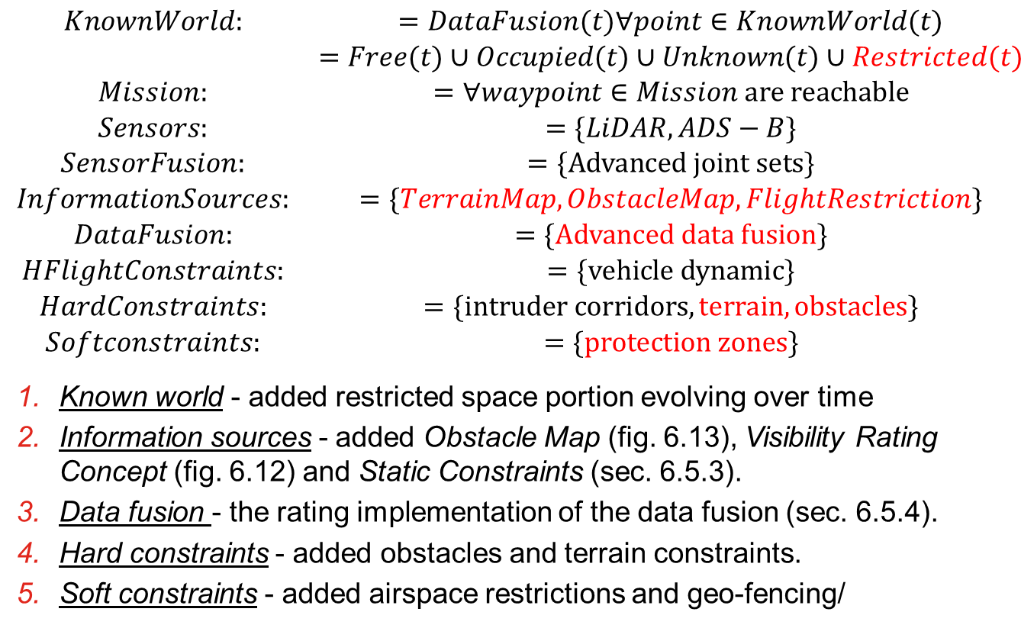
Incremental problem definition: [P3] Static restrictions
$$\begin{matrix}KnownWorld: & =DataFusion(t)∀point∈KnownWorld(t) \\ & =Free(t)∪Occupied(t)∪Unknown(t)∪Restricted(t) \\ Mission: & =∀waypoint∈Mission are reachable \\ Sensors: & =\{LiDAR,ADS−B\} \\ SensorFusion: & =\{Advanced joint sets\} \\ InformationSources: & =\{TerrainMap,ObstacleMap,FlightRestriction\} \\ DataFusion: & =\{Advanced data fusion\} \\ HFlightConstraints: & =\{vehicle dynamic\} \\ HardConstraints: & =\{intruder corridors,terrain,obstacles\} \\ Softconstraints: & =\{protection zones\}\end{matrix}$$
Known world - added restricted space portion evolving over time
Information sources - added Obstacle Map (fig. 6.13), Visibility Rating Concept (fig. 6.12) and Static Constraints (sec. 6.5.3).
Data fusion - the rating implementation of the data fusion (sec. 6.5.4).
Hard constraints - added obstacles and terrain constraints.
Soft constraints - added airspace restrictions and geo-fencing/
Notes:
Speech:
Let us add “static constraints” and restrictions, originating from:
1. Terrain Map – from our previous flights
2. Obstacle Map – from future UTM,
3. Flight restrictions – from airspace authority,
The data fusion now needs to handle prioritization,
Evaluate the threat potential,
Note:
Refer to the map from the introduction for “restricted airspace”.
The supplement ratings needed to be introduced, like visibility (6.13) and static constraints (6.5.3)
The final form of data fusion has been outlined (6.5.4)
Your Notes:

Slide 32
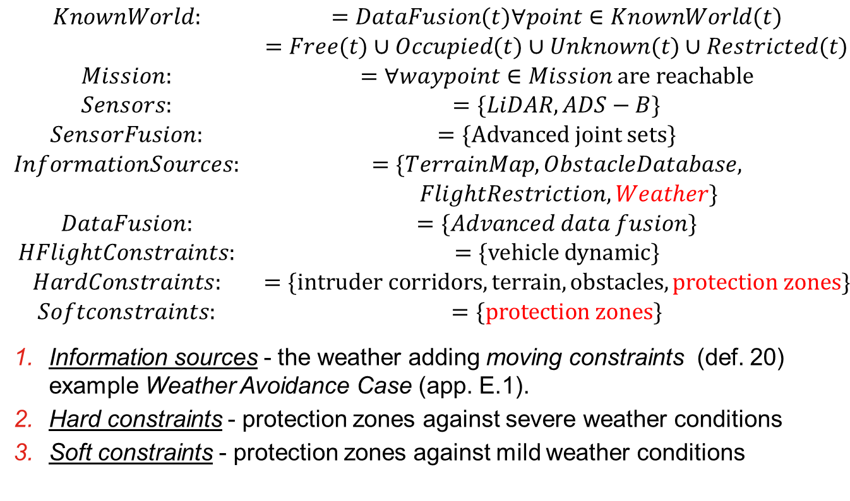
Incremental problem definition: [P4] Dynamic restrictions
$$\begin{matrix}KnownWorld: & =DataFusion(t)∀point∈KnownWorld(t) \\ & =Free(t)∪Occupied(t)∪Unknown(t)∪Restricted(t) \\ Mission: & =∀waypoint∈Mission are reachable \\ Sensors: & =\{LiDAR,ADS−B\} \\ SensorFusion: & =\{Advanced joint sets\} \\ InformationSources: & =\{TerrainMap,ObstacleDatabase, \\ & FlightRestriction,Weather\} \\ DataFusion: & =\{Advanced data fusion\} \\ HFlightConstraints: & =\{vehicle dynamic\} \\ HardConstraints: & =\{intruder corridors,terrain,obstacles, protection zones\} \\ Softconstraints: & =\{protection zones\}\end{matrix}$$
Information sources - the weather adding moving constraints (def. 20) example Weather Avoidance Case (app. E.1).
Hard constraints - protection zones against severe weather conditions
Soft constraints - protection zones against mild weather conditions
Notes:
Speech:
The weather compliance is necessary for controlled airspace integration, considering the average UAS size,
1. The weather consists of static phenomenon like focused storm or moving phenomenon like wind gusts,
This introduces a new type of “moving constraint” which needs to be accounted from greater range,
2. Depending on the UAS construction and future durability requirements,
Some of the weather cases may be ignored, this gives us “soft constraints”.
[Note]
Weather covers all types of constraints due its phenomena variability.

Slide 33
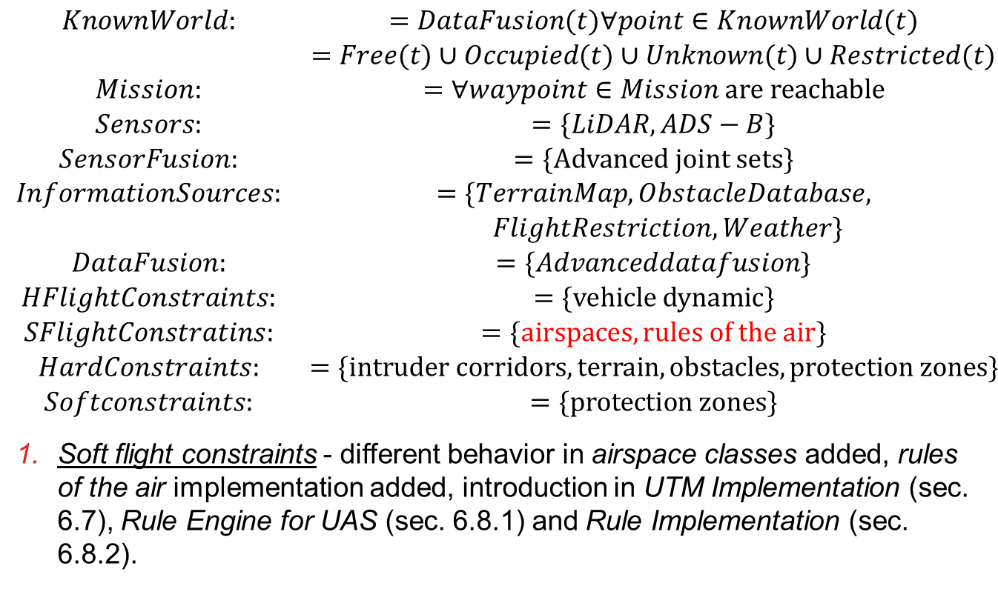
Incremental problem definition: [P5] Rules of the air
$$\begin{matrix}KnownWorld: & =DataFusion(t)∀point∈KnownWorld(t) \\ & =Free(t)∪Occupied(t)∪Unknown(t)∪Restricted(t) \\ Mission: & =∀waypoint∈Mission are reachable \\ Sensors: & =\{LiDAR,ADS−B\} \\ SensorFusion: & =\{Advanced joint sets\} \\ InformationSources: & =\{TerrainMap,ObstacleDatabase, \\ & FlightRestriction,Weather\} \\ DataFusion: & =\{Advanceddatafusion\} \\ HFlightConstraints: & =\{vehicle dynamic\} \\ SFlightConstratins: & =\{airspaces, rules of the air\} \\ HardConstraints: & =\{intruder corridors,terrain,obstacles, protection zones\} \\ Softconstraints: & =\{protection zones\}\end{matrix}$$
Soft flight constraints - different behavior in airspace classes added, rules of the air implementation added, introduction in UTM Implementation (sec. 6.7), Rule Engine for UAS (sec. 6.8.1) and Rule Implementation (sec. 6.8.2).
Notes:
Speech:
The final step for airspace integration is authority obedience,
The avoidance and navigation mechanisms needs to adhere to “rule of the air” dependent on “airspace context”,
There is a set of internationally rules stated in ICAO annex 2, which outlines required behavior for any aircraft,
Your Notes:

Slide 34
Related work: Movement Automaton Surveillance Navigation Reach set estimation
Notes:
Speech:
The goal is to provide the answer to given challenges.
We need a tools for:
1. An UAS discrete control,
2. Surroundings surveillance,
3. Short-term/Long term navigation,
4. Reach set estimation/approximation
Your Notes:

Slide 35
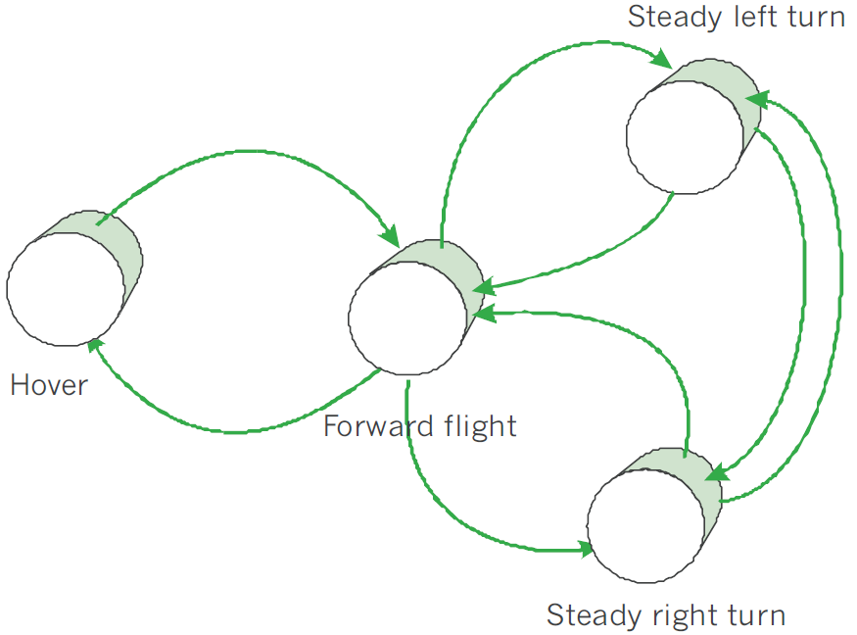
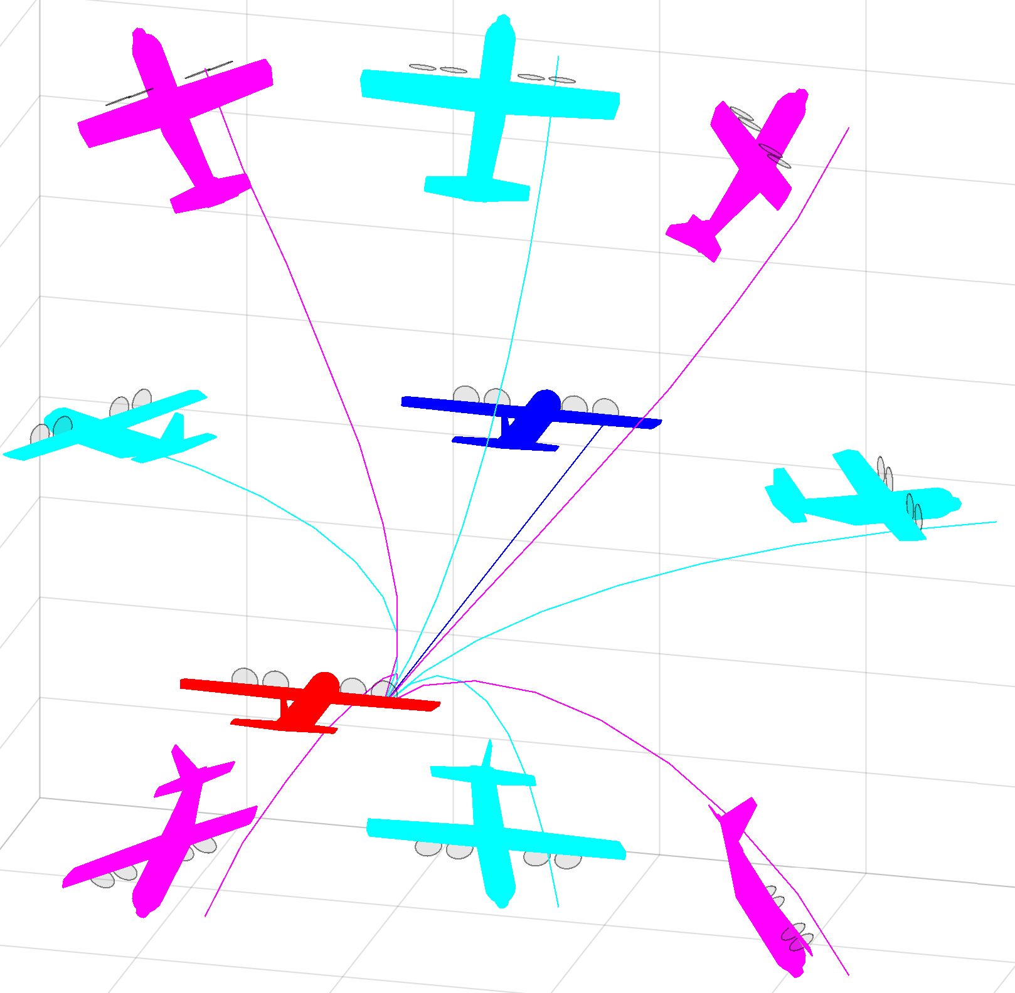
Related work: Movement automaton (5.1)
Related work:
[15] Emilio Frazzoli. Robust hybrid control for autonomous vehicle motion planning. PhD thesis, Massachusetts Institute of Technology, 2001.
[91] Emilio Frazzoli, Munther A Dahleh, and Eric Feron. Trajectory tracking control design for autonomous helicopters using a backstepping algorithm. In American Control Conference, 2000. Proceedings of the 2000, volume 6, pages 4102-4107. IEEE, 2000.
Notes:
Speech:
There is special type of “hybrid automaton” called,
“movement automaton”, which provides sufficient,
abstraction to be reused on different platforms
“Our movement automaton” is based on work of,
“Emillio Frazolli”,
Movement automaton hase the finite set of possible,
movements, which supports determinism (green picture)
Note:
In the picture you can see the example of used movement set [red plane is origin], [cyan/magenta plane after movement]
Your Notes:

Slide 36
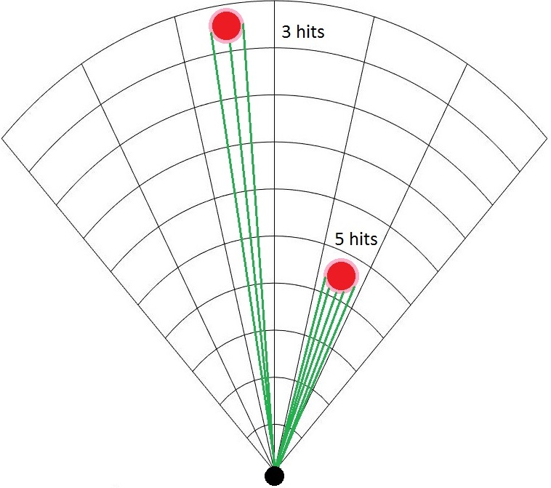
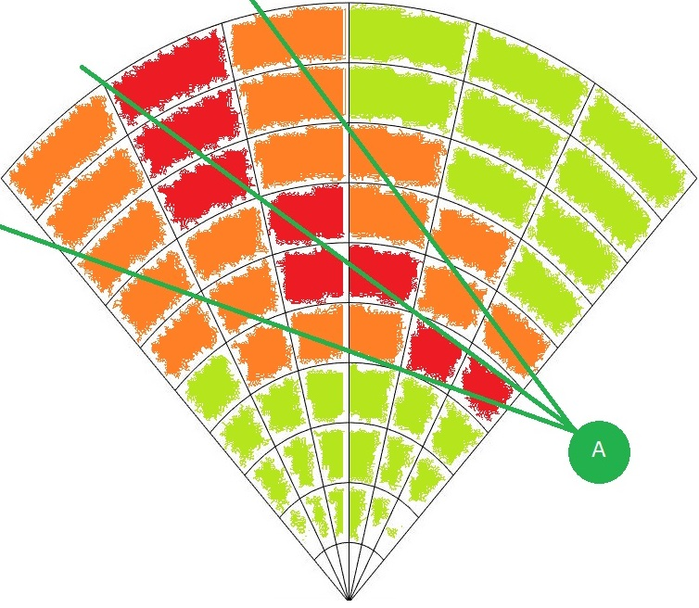
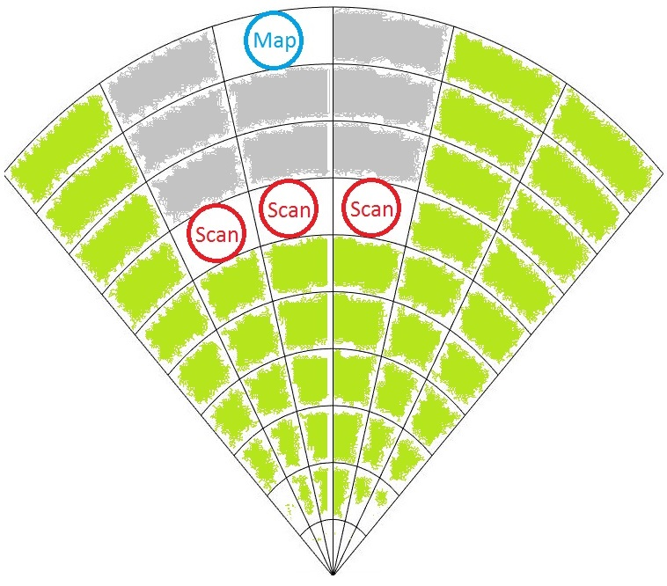
Related work: Surveillance (5.2)
Related work:
[98] Fredrik Gustafsson. Statistical sensor fusion. Studentlitteratur, 2010.
[99] Subramanian Ramasamy, Roberto Sabatini, Alessandro Gardi, and Trevor Kistan.
Next generation fight management system for real-time trajectory based
operations. Applied Mechanics and Materials, 629:344-349, 2014.
[100] Yuriy Chynchenko, Tatyana Shmelova, and Oksana Chynchenko. Remotely
piloted aircraft systems operations under uncertainty conditions. Proceedings of
the National Aviation University, 1(1):18-22, 2016.
[101] T Shmelova, D Bondarev, and Y Znakovska. Modeling of the decision making by
UAS operator in emergency situations. In Methods and Systems of Navigation
and Motion Control (MSNMC), 2016 4th International Conference on, volume 1,
pages 31-34. IEEE, 2016.
Notes:
Speech:
The world map is represented as a set of cells,
Each cell has a rated property, like visibility, reachability,
The “Data fusion” procedure which evaluates these properties is based on work of Gustafson and Ramasy,
Note:
From left to right (examples of properties):
1. Intruder intersection rate
2. Obstacle map rate
3. LiDAR hit count
Your Notes:

Slide 37
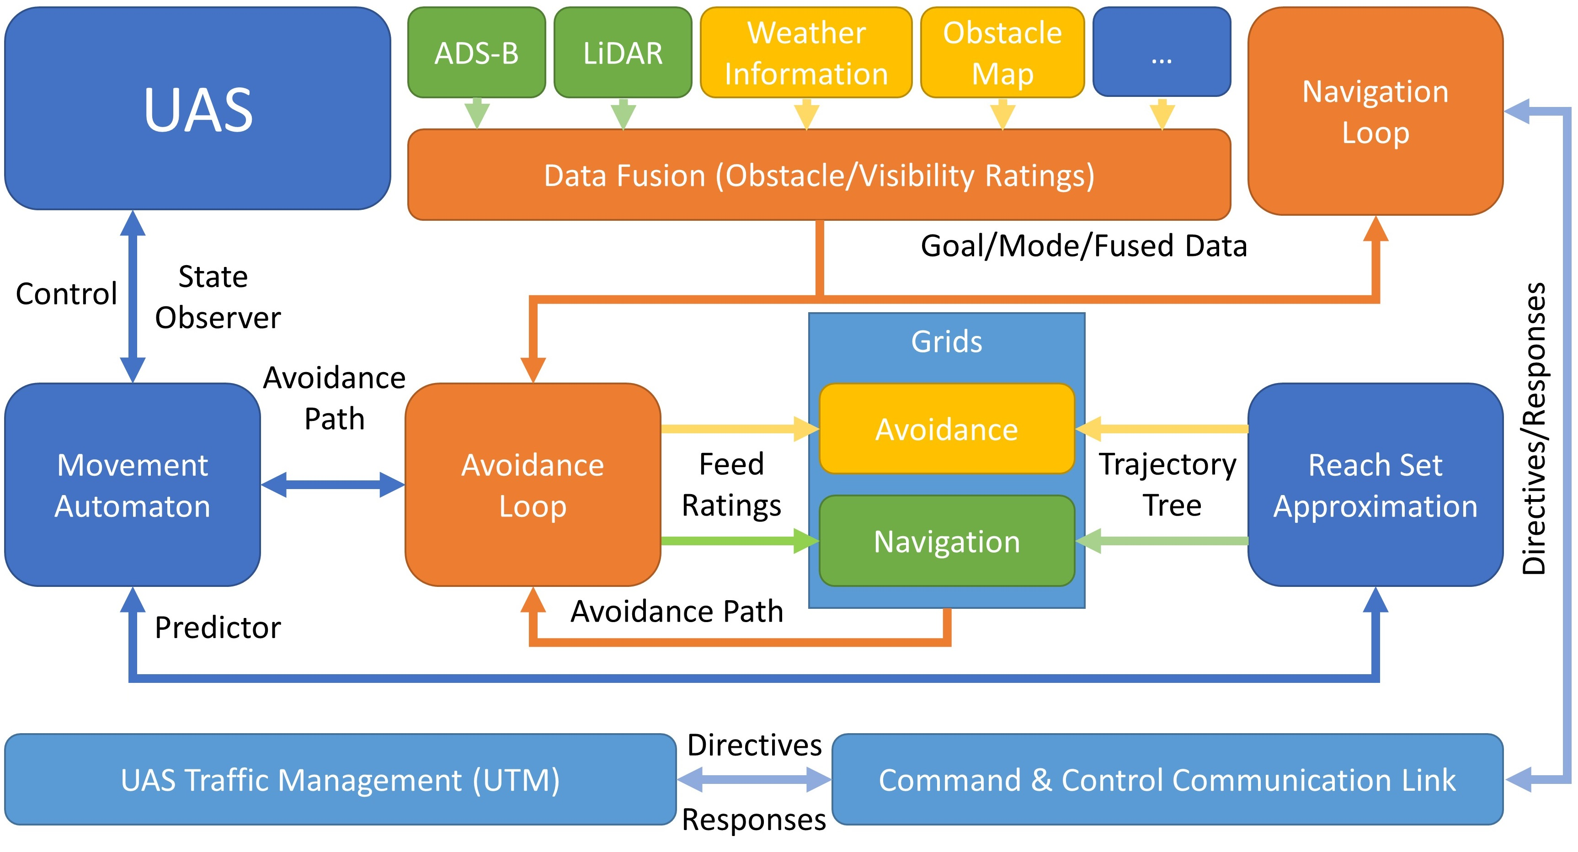
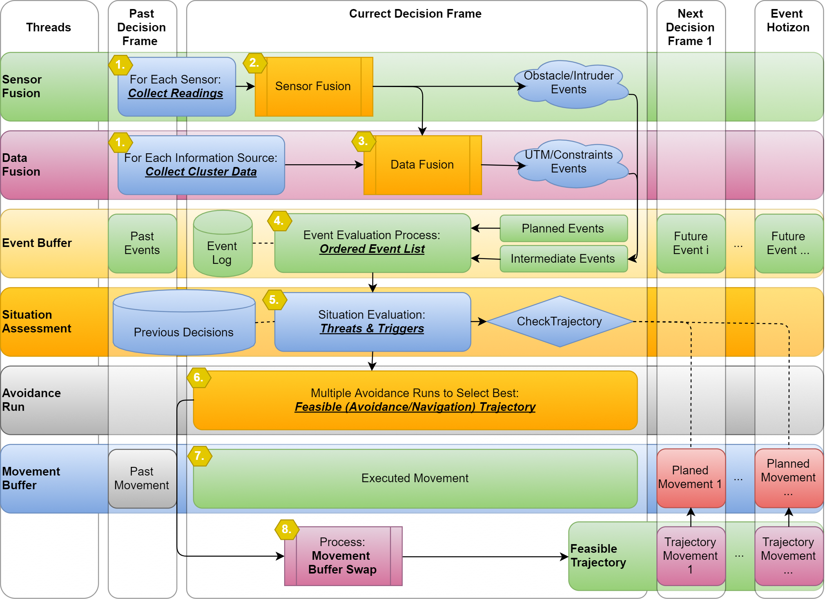
Related work: Navigation (5.3)
Related work:
[167] Roberto Sabatini, Celia Bartel, Anish Kaharkar, Tesheen Shaid, and
Subramanian Ramasamy. Navigation and guidance system architectures for
small unmanned aircraft applications. International Journal of Mechanical,
Industrial Science and Engineering, 8(4):733-752, 2014.
[168] Roberto Sabatini, Alessandro Gardi, and M Richardson. Lidar obstacle warning
and avoidance system for unmanned aircraft. International Journal of
Mechanical, Aerospace, Industrial and Mechatronics Engineering, 718-729,2014.
Notes:
Speech:
The navigation is understood as synergy of multiple immediate decisions to achieve,
“long-term safe path” between waypoints.
The Sabatini and Gardi laid out the base for UAS
Note:
From left to right:
1. Simplified navigation framework structure,
2. Simplified navigation activity diagram,
Your Notes:

Slide 38
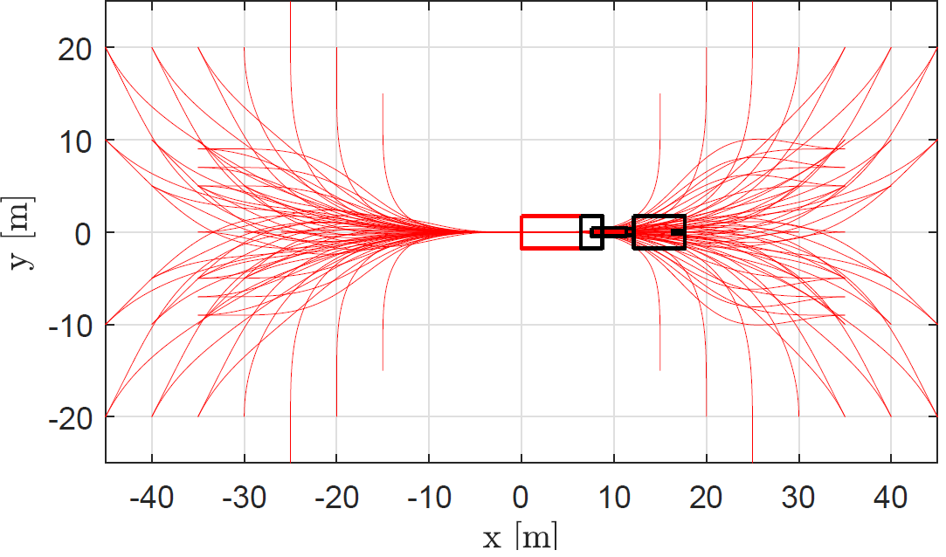
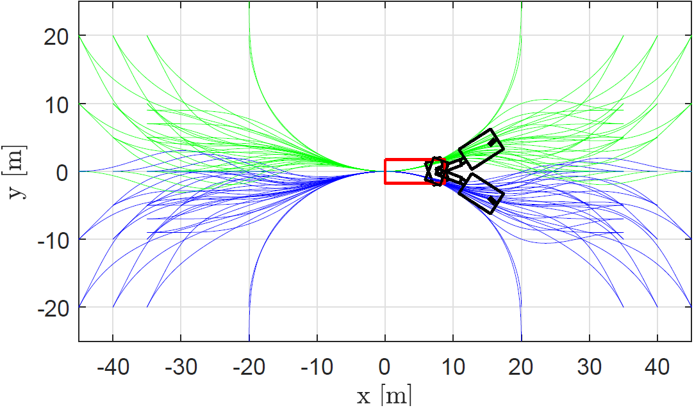
Related work: Reach Set Estimation (5.4)
Related work:
[108] Steven M LaValle, Michael S Branicky, and Stephen R Lindemann. On the
relationship between classical grid search and probabilistic roadmaps. The
International Journal of Robotics Research, 23(7-8):673-692, 2004.
[109] Ira M Gessel. A probabilistic method for lattice path enumeration. Journal of
statistical planning and inference, 14(1):49-58, 1986.
[110] Floriana Esposito, Donato Malerba, Giovanni Semeraro, and J Kay. A
comparative analysis of methods for pruning decision trees. IEEE transactions
on pattern analysis and machine intelligence, 19(5):476{491, 1997.
Notes:
Speech:
The reach set defines where can UAS fly from initial position in given time frame,
We want to have finite count of possibilities to guarantee finite time solution,
The “lattice trajectory tree” is a finite set of possible maneuvers,
originating in one initial position , and it fulfils this purpose,
The work of LaValle, Gessel, and, Esposito are used as base for our algorithm.
Note:
On the picture the “reach set approximation” for truck in different starting positions
Your Notes:

Slide 39
Proposed Framework: Overview Avoidance Run UTM Implementation Rule Engine
Notes:
Speech:
That’s all for the introduction,
Let us get to the proposed framework,
Your Notes:

Slide 40


Proposed framework Overview
Navigation Loop
Data Fusion
ADS-B
Situation Assessment
Events
Triggers
LiDAR
Goal Waypoint
Weather
Directives
Changes
Directives
Avoidance Run
Avoidance Grid
Map
Avoidance Trajectory
Restrictions
Reach Set
Ratings
Notes:
Speech:
The framework works like follow:
1. The entry point is Data fusion (green <plane> box),
2. Data fusion gives “Situation overview” to “Avoidance Run”,
3. “Avoidance Run” (orange box) stores the situation in “Grid”,
4. The “Situational Assessment” (blue box) based on “Goal waypoint” and “rules” selects the most feasible “short-term avoidance trajectory” from the reach set.
5. The “Navigation loop” is responsible for long term navigation.
6. The movement automaton is responsible for “reference path translation”
Then let us look on details.
Your Notes:

Slide 41
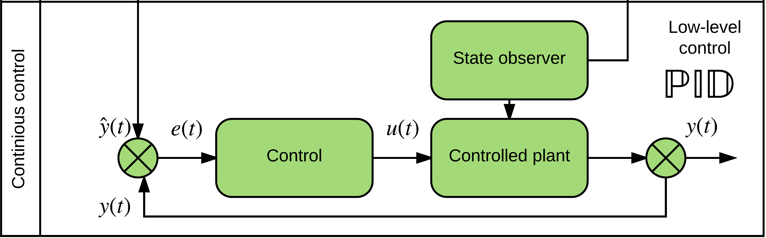
UAS model
ADS-B
Obstacle Map
LiDAR
Rule Engine
Data fusion
Mission Plan
Avoidance grid
UAS model
Movement Automaton
Reach set approximation
Notes:
Speech:
The controlled plant (sec. 6.2) for UAS model, is continuous time system, (dramatic pause, click)
Your Notes:

Slide 42
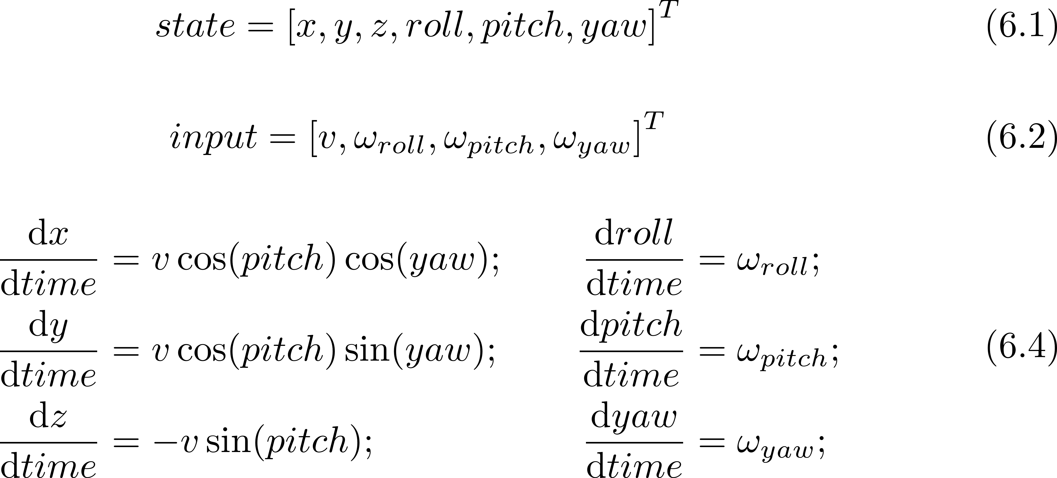
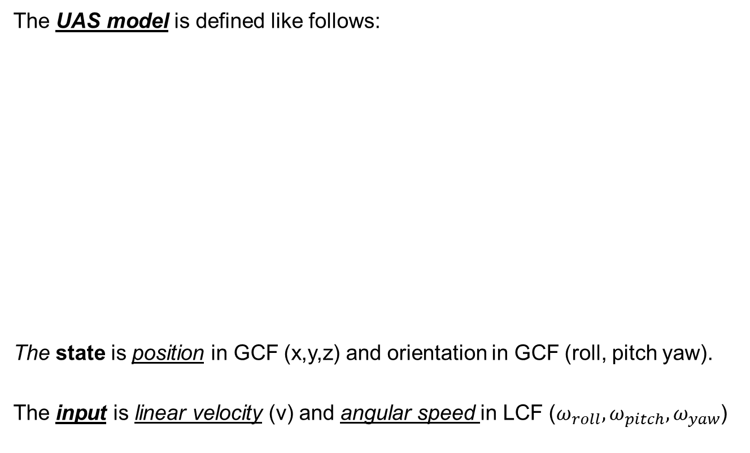
UAS model: 3D unicycle (6.2.2)
The UAS model is defined like follows:
The state is position in GCF (x,y,z) and orientation in GCF (roll, pitch yaw).
The input is linear velocity (v) and angular speed in LCF ($ω_{roll},ω_{pitch}, ω_{yaw}$)
Notes:
Speech:
The UAS model is simple 3D unicycle,
With position (GCF) and orientation (GCF) as a state (6.1)
And control input as scalar velocity and angular velocity (6.2),
The model is then given by set of equations (6.4).
Note:
The simple model was used to ease reach set estimation experimentation,
The angular velocities are decoupled,
Your Notes:

Slide 43
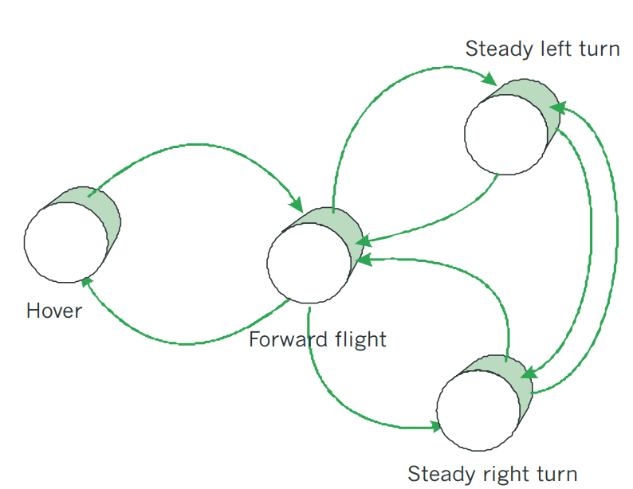
Movement Automaton
ADS-B
Obstacle Map
LiDAR
Rule Engine
Data fusion
Mission Plan
Avoidance grid
UAS model
Movement Automaton
Reach set approximation
Notes:
Speech:
The UAS is controlled via Movement automaton
Movement automaton consumes commands – movements,
In the picture you can see example of simple Copter movement automaton, with four movements,
Note:
The movement automaton is just hybrid automaton with enforced state changes.
Your Notes:

Slide 44
Movement Automaton: Movement set (6.2.3)
A movement set have been implemented containing movements lasting 1s:
The movement execution, with initial state represented as a red plane, looks like follow:
Notes:
Speech:
The movement set is a set of automaton states,
For our model there is a possibility to deriver nine (9) “elementary movements” (6.11),
In the picture the red plane shows the position before movement application, other colors after movement application
Note:
Similar movement set can be achieved for many UAS models,

Slide 45
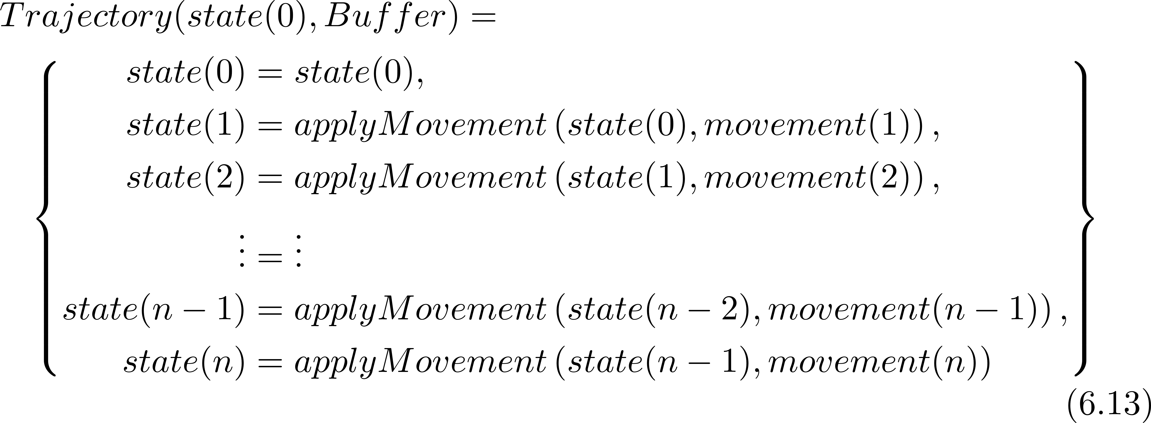
Movement Automaton: Trajectory (6.2.3)
A buffer is an ordered list of movements to be executed by UAS:
The trajectory for some initial state(0) and buffer is given as:
Notes:
Speech:
The buffer is created by chaining multiple elementary movements as command chain,
The command chain is stored in Buffer structure (6.12),
The movement automaton continuously consumes buffer to control UAS over trajectory,
The trajectory for some initial state and buffer is given as,
The chain of the state changes with corresponding movement applications (6.13).
Your Notes:

Slide 46
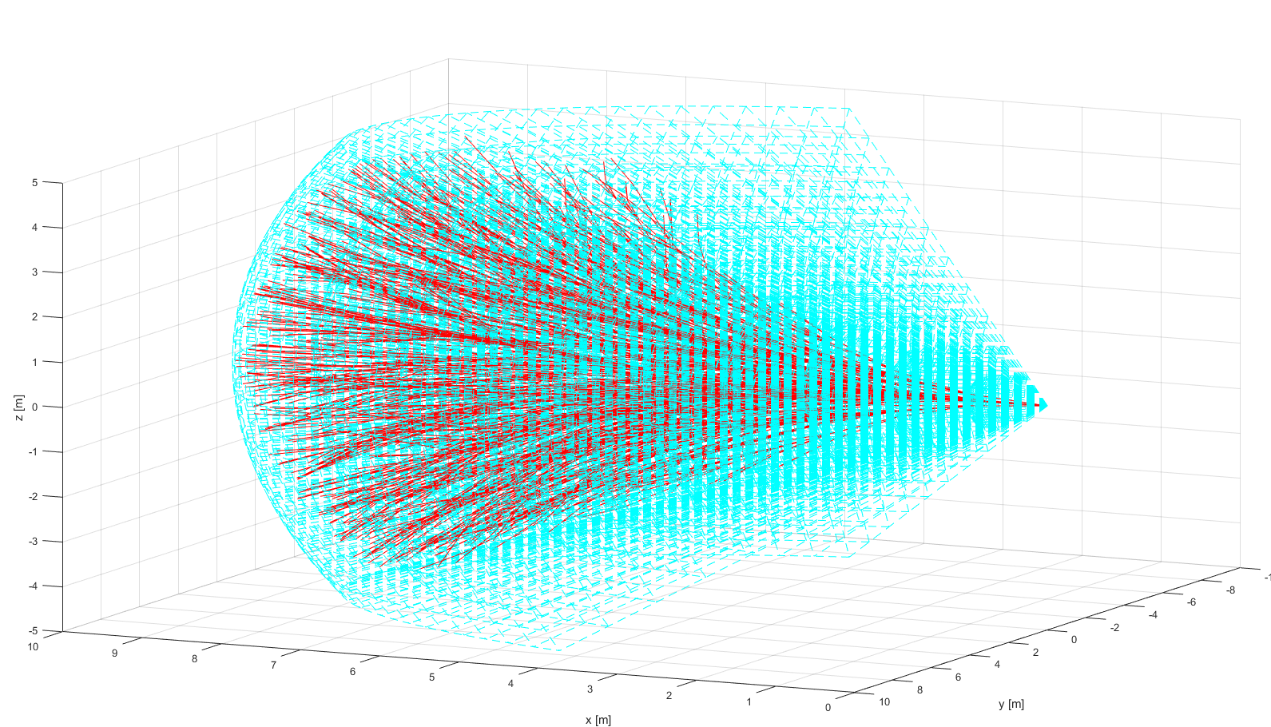
Reach set approximation
ADS-B
Obstacle Map
LiDAR
Rule Engine
Data fusion
Mission Plan
Avoidance grid
UAS model
Movement Automaton
Reach set approximation
Notes:
Speech:
The Reach set is used for decision making,
It can be imagined as “tree of trajectories”,
Example: Reach set using our method (red) in Field of vision (aquamarine),
Your Notes:

Slide 47
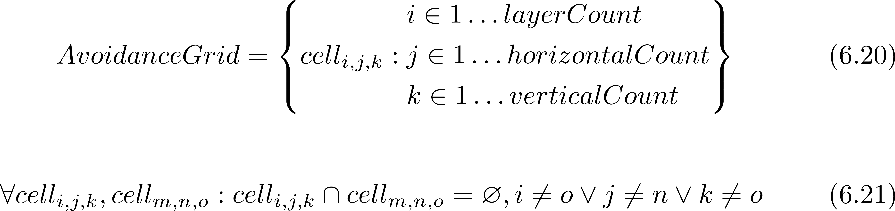
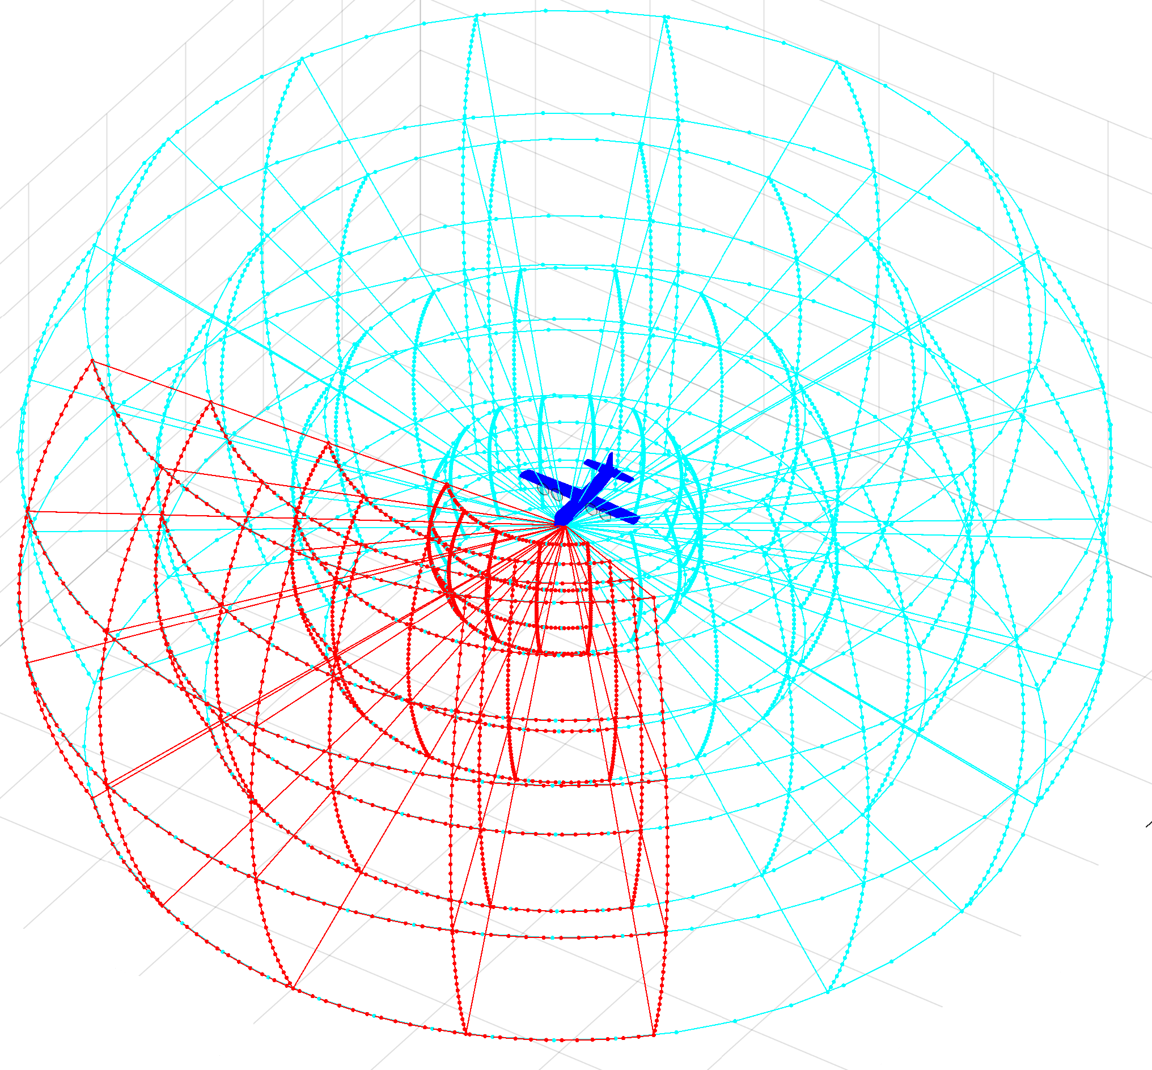
Reach set approximation Space segmentation – Avoidance Grid (6.3)
An intermediate operational space is segmented into avoidance grid:
In segmented discrete operational space represented as avoidance grid:
Notes:
Speech:
The UAS operational space is represented by
“Avoidance grid” (6.20)
Avoidance grid represented in planar coordinates is split into the uniform cells with space portion (6.15)
The avoidance grid is organized in layers of cells with common distance range,
The example of avoidance grid for blue aircraft in LiDAR vision range
Is shown by blue color.
Note:
The space bounded by cells is exclusive (6.21).
Your Notes:

Slide 48


Reach set approximation The RSA definition
One cell space portion is bounded by:
Refer to (def. 11,12)
The Reach Set Approximation (RSA)is a set of trajectories with common origin:
Notes:
Speech:
The cell is portion of 3D space bounded by (6.15),
Then the Reach set approximation is given as a set of trajectories originating in “initial state” with limited duration (6.23),
The trajectory is given as a execution of movement chain - “buffer” applied on initial state,
Note:
Refer to section (6.4.1) for detailed explanation.
The cell is considered as one entity with common parameters.
Your Notes:

Slide 49


Reach set approximation: Trajectory properties (6.4.2)
Coverage – the trajectory footprint
6 trajectories 3 unique footprints
Turn ratio – count of turning movements
Try to minimize turning in reach set !
Notes:
Speech:
The goal is to have trajectories in Reach Set Approximation which increases the odds of survival,
The trajectory relation to the “avoidance grid” is given by its footprint, the set of cells passed by trajectory,
In the left figure you can see six trajectories going over avoidance grid,
There are only three unique trajectory footprints,
That means we need only 3 of those trajectories,
The right figure shows four trajectories with same footprint
Your Notes:

Slide 50

Reach set Approximation Property based approximations (6.4.3)
Get the
minimal
discrete trajectory set (RSA)
covering
all possible maneuvers
Reach set Approximation
Calculation Process (6.4.3)
Notes:
Speech:
The trajectory properties are considered when the candidate trajectory for Reach set approximation is selected,
In the figure you can see selection process based on coverage property,
Note:
You can track any property of the trajectory in relation to operational space or airspace, as you will see later,
Your Notes:

Slide 51


Reach set approximation: Developed Reach set Approximations 1/2
Coverage-maximizing RSA (6.4.4)
Contains trajectories with: high coverage rate
Useful for: intruder/obstacle avoidance
In: Non-controlled airspace
Turn-minimizing RSA (6.4.5)
Contains trajectories with: high smoothness
Useful for: Navigation
In: Non-controlled airspace
Notes:
Speech:
Following reach set approximations were developed:
1. Coverage maximizing (6.4.4)
A. contains trajectories maximizing avoidance capability
B. Used for intruder/obstacle avoidance
C. In non-controlled airspace
2. Turn minimizing (6.4.5)
A. Contains trajectories with minimal turning,
B. Used for navigation, increases behavior predictability,
C. Used in non-controlled airspace
Your Notes:

Slide 52


Reach set approximation: Developed Reach set Approximations 2/2
Combined RSA (6.4.7)
Contains trajectories with: TM + CM RSA combination
Useful for: avoidance/navigation
In: Controlled airspace in case of Emergency
ACAS-like RSA (6.4.6)
Contains trajectories with: ACAS behavior
Useful for: Navigation/UTM Resolutions
In: Controlled airspace
Notes:
Speech:
The idea behind combined RSA (6.4.7) is to have properties of both turn minimizing and coverage maximizing RSA.
To be compatible with controlled airspace, the “ACAS-like” (6.4.6) RSA was developed to emulate horizontal/ vertical/ cross section separations of modern aircrafts.
Note:
All reach sets are for 3D space
ACAS operational mode can be constrained.

Slide 53

Mission plan
ADS-B
Obstacle Map
LiDAR
Rule Engine
Data fusion
Mission Plan
Avoidance grid
UAS model
Movement Automaton
Reach set approximation
Notes:
Speech:
To use Reach set Approximation, we need a mission plan,
The mission plan is given as ordered set of waypoints,
The example shows a trajectory with multiple decisions
Your Notes:

Slide 54

ADS-B
ADS-B
Obstacle Map
LiDAR
ADS-B
Rule Engine
Data fusion
Mission Plan
Avoidance grid
UAS model
Movement Automaton
Reach set approximation
Notes:
Speech:
To evaluate situation we need some input data,
For intruder position the ADS-B is used,
Each air traffic attendant is broadcasting its position and heading,
Your Notes:

Slide 55

LiDAR
ADS-B
Obstacle Map
LiDAR
Rule Engine
Data fusion
Mission Plan
Avoidance grid
UAS model
Movement Automaton
Reach set approximation
Notes:
Speech:
LiDAR is a sensor of choice for static obstacles,
In the example data you can see a small farm,
Note:
Moving object filtering is neglected

Slide 56



Offline Maps – created from classified data
All data
Vegetation
Terrain
Buildings
[*] Maria Cerna. Usage of maps obtained by lidar in uav navigation. Master thesis, Institute of Automotive Mechatronics,
Faculty of Electrical Engineering and Information Technology, Slovak University of Technology, Ilkovicova 3, Bratislava. Slovak Republic, jun 2018.
Notes:
Speech:
LiDAR classification algorithms can be used for the,
“Offline maps” creation,
In the example you can see farm data (NW) classification,
For vegetation (NE), Terrain (SW), Buildings (SE),
Your Notes:

Slide 57

Obstacle Map
Obstacle Map
ADS-B
Obstacle Map
LiDAR
Rule Engine
Data fusion
Mission Plan
Avoidance grid
UAS model
Movement Automaton
Reach set approximation
Notes:
Speech:
There is an example of offline map created by one of my master students,
Note:
Here is example of cuboid coatings (dark blue) with virtual convex coating (magenta, cyan, yellow, red)
Your Notes:

Slide 58




Avoidance Grid
ADS-B
Obstacle Map
LiDAR
Rule Engine
Mission Plan
Data fusion
Avoidance grid
UAS model
Movement Automaton
Reach set approximation
Notes:
Speech:
Now we have all the ingredients for Data fusion and Avoidance Run
The Avoidance Run is situation evaluation for one specific decision time point,
Your Notes:

Slide 59

Avoidance run (6.5.1) Step 1/7 Initialization
Notes:
Speech:
First we start with empty avoidance grid,
The goal is green square,
The UAS position is blue square,
Your Notes:

Slide 60

Avoidance run (6.5.1) Step 2/7 Threat (obstacle) assessment
Notes:
Speech:
The “Data fusion” provides threat rating (obstacle rating) each cell in avoidance grid
Red cells are occupied,
Note:
Red cells belongs to occupied space
Red cells can belong alsto to restricted space
Your Notes:

Slide 61
Avoidance run (6.5.1) Step 3/7 Unknown state of the cells
Notes:
Speech:
Then we evaluate the unknown as yellow cells,
Note:
The unknow portion of operation space belongs to Uncertain set,

Slide 62
Avoidance run (6.5.1) Step 4/7 Reach set approx. projection
Notes:
Speech:
Then then we project reach set approximation into avoidance grid,
The result is trimmed reach set with only safe green trajectories,
Note:
The safe trajectory is a trajectory going over Free space (white)
Your Notes:

Slide 63
Avoidance run (6.5.1) Step 6/7 Reachable/Unreachable
Notes:
Speech:
The green cells which are penetrated by at least one safe trajectory are considered reachable,
The orange unreachable cells do not have any.
Note:
Reachable + Unreachable = Free operational space
Your Notes:

Slide 64

Avoidance run (6.5.1) Step 7/7 Trajectory selection
Notes:
Speech:
The navigation algorithm provides navigation goal (purple star).
Then in the reachable space a feasible blue avoidance path is selected from constrained reach set,
The blue star is marked as next decision point,
We fire up Avoidance Run again there
Note:
The path is selected according to the cost function and safety rules
Your Notes:

Slide 65
Mission control run (6.5.2) Multiple avoidance run joined together
Notes:
Speech:
The avoidance run is responsible for “Short term navigation”, for long term navigation mission control run is used.
Multiple avoidance runs are executed to create one safe trajectory,
The cyan trajectory is planned from next decision point,
Note:
Mission control run is far more complex with magnitude of rules and other mechanisms,
It has been neglected in this presentation for simplicity purpose,
Your Notes:

Slide 66

UAS Traffic Management Concept
Each vehicle is calculating Collision Cases to nearby vehicles,
UTM is also calculating Collision Cases to cluster vehicles,
UTM issues Resolution advisories or separation rules to prevent collision
Resolution
UAS 1
Mission Control
Navigation Grid
Collision Case
Position notification
UAS Traffic Management
UAS 2
Position notification
Mission Control
Navigation Grid
Resolution
Notes:
Speech:
That was all for framework,
We need to make multiple instances to cooperates, for UAS to be airworthy,
This schematic shows a concept of centralized UTM,
UTM is receiving position updates from aircrafts,
If UTM detects collision its sends “Collision Resolutions”,
Your Notes:

Slide 67
Rule engine
Context
Gather
Context
Rule Engine
Invoke
Engine
Decision point
(Join point)
Mission Control
Rule
Navigation Grid
My mission
Velocity Recalculation
Invoke Rule Instance
Parser
Check condition:
Intruder Velocity
Application
Parse context:
Intruder Position
Take action:
Slow down
Condition
Notes:
Speech:
Because UAS operates in very complex space we needed a mechanism to tweak navigation/avoidance process,
The simple rule engine has been implemented which enables code injection in specific joint points
The example shows slow down rule for “C” class airspace,
Your Notes:

Slide 68
Simulations: Test plan
Notes:
Speech:
That’s all for the framework,
Now lets get to the testing scenarios
Your Notes:

Slide 69

Test plan (7.1)
Notes:
Speech:
We have developed own testing framework enabling us to test:
1. Static obstacle collisions.
2. Intruder collision,
3. Weather avoidance,
4. Combination of any previous,
We have prepared and executed 13 scenarios,
Your Notes:

Slide 70
Simulations Maze Solver Storm Avoidance
Notes:
Speech:
Firstly, I will show you two scenarios for obstacle avoidance and weather avoidance
Your Notes:

Slide 71

Scenario (7.3.3) Maze
Notes:
Lets call it “Standard pizza delivery scenario”
The “blue plane” is flying over the maze to the green square waypoint,
The blue line is already flew trajectory
The red line is planned trajectory for actual decision point
The non convex obstacles are fed to “LiDAR” sensor
As you can see the approach has maze solving capabilities
Note:
The UAS is capable to fly over buildings, The framework and reach sets are primarily 3D
The UAS is fed only over Sensor simulation, it does not know the mission plan or obstacle layout
Your Notes:

Slide 72

Scenario (7.3.4): Storm
Notes:
Speech:
The blue plane is approaching magenta storm,
The storm is considered as moving constraint
The plane avoids storm
Your Notes:

Slide 73
Rules of the Air Simulations: Converging Maneuver Head On Approach Overtake
Notes:
Speech:
To be airworthy UAS needs to adhere some basic traffic rules, I will demonstrate the rules of the air which are valid for “controlled airspace”
Note:
Class C, A, airspaces, B are airports, they have more complex and intricate rules,
Your Notes:

Slide 74


Converging Maneuver - Trigger
$$α≥{70}^{o}$$
Notes:
Speech:
The converging maneuver needs to be executed when the angle of approach is above seventy degrees,
The right hand rule is applied,
The red plane has right of the way,
Your Notes:

Slide 75
Converging Maneuver - Resolution
Turn right and stay away from approaching aircraft
Notes:
Speech:
The blue plane start avoidance keeping safe distance
Your Notes:

Slide 76
Converging Maneuver – Leave condition
Return to original path behind other aircraft
Notes:
Speech:
The blue plane avoids wake turbulence and returns to original path

Slide 77

Scenario (7.4.1): Rule-based converging
Notes:
Speech:
Blue plane avoids magenta plane, which has
“right of the way”
The rule engine has been deployed to tweak process,
Your Notes:

Slide 78



Head On Approach - Trigger
$$α≥{130}^{o}$$
$$r≥s_{m}$$
Applies when angle of approach $α≥{130}^{o}$, Safety margin $s_{m}$ is given as (2x) 5m
Notes:
Speech:
The “Head on approach” is triggered when the angle of approach is greater than 130 degrees
None of planes has the right of the way,
The virtual round abound concept is used
Your Notes:

Slide 79
Head On Approach - Resolution
$$r≥s_{m}$$
Both vehicles are taking right side avoidance
Notes:
Speech:
Both planes keep safe distance from expected collision point to avoid wake and side turbulences
The maneuver ends when virtual roundabout is used
Note:
Every rule can fail, then its “Every man for himself” situation solved by “upper right corner” avoidance.
Your Notes:

Slide 80

Scenario (7.4.2): Rule-based head-on
Notes:
Speech:
The collision point is used as a center of virtual roundabout
Both planes start to converge to original waypoint when the collision point is passed,
Your Notes:

Slide 81


Overtake Maneuver - Trigger
$$\left\langle \begin{matrix}Convergence \\ Waypoint\end{matrix}\right\rangle$$
$$\left\langle \begin{matrix}Divergence \\ Waypoint\end{matrix}\right\rangle$$
The aircraft being overtaken has the right of the way
Notes:
Speech:
Faster blue airplane is overtaking slower red airplane
Faster blue airplane needs to take detour,
The standard solution is to follow divergence waypoint and start returning on convergence waypoint
Your Notes:

Slide 82
Overtake Maneuver - Resolution
$$\left\langle \begin{matrix}Convergence \\ Waypoint\end{matrix}\right\rangle$$
$$\left\langle \begin{matrix}Divergence \\ Waypoint\end{matrix}\right\rangle$$
Overtake is executed from right
Notes:
Speech:
It’s going like this,
During overtake both planes should keep constant speed
Your Notes:

Slide 83
Overtake Maneuver – Leave Condition
$$\left\langle \begin{matrix}Convergence \\ Waypoint\end{matrix}\right\rangle$$
$$\left\langle \begin{matrix}Divergence \\ Waypoint\end{matrix}\right\rangle$$
Overtake rule may apply only when well clear condition is guaranteed
Notes:
Speech:
Then it finishes like this
Your Notes:

Slide 84

Scenario (7.4.4): Rule-based overtake
Notes:
Speech:
Here you can see overtake maneuver implemented in our framework,
The blue plane is following the divergence waypoint
The blue plane returns on convergence waypoint when its wake turbulence does not harm magenta plane
Your Notes:

Slide 85

Different speed: Overtake Maneuver
Notes:
Speech:
The divergence and convergence waypoints are calculated according to vehicle classes and speed difference,
Here you can see how the overtake trajectory wider with increase of speed difference
Note:
The speed difference changes the shape of overtake trajectory,
The turn angle and shape is getting more sharp
Blue trajectory shows overtake with 2x speed difference
Green trajectory shows overtake with 3x speed difference
Black trajectory shows overtake with 4x speed difference.

Slide 86
Simulations: Cooperative vs. Noncooperative Multi-Collision Situations
Notes:
Speech:
The multi collision can be solved in cooperative or non-cooperative manner, let’s take look on some more complex scenarios.
Your Notes:

Slide 87
Cooperative separation scenario
Position Notification
Position Notification
UAS 1
2
UAS 3
1
Calculate collision Cases
Create Virtual
Roundabout
Directive
Directive
UAS Traffic Management
Directive
Directive
Send
Directives
Enforce
Directives
3
4
UAS 2
UAS 4
Position Notification
Position Notification
Notes:
Speech:
There is a central UTM authority,
The UAS gives their “Position notification”,
The UAS is enforcing “Directives as a commands”,
Your Notes:

Slide 88

Scenario (7.4.3): Rule-based mixed head-on with converging
Notes:
Speech:
In controlled airspace, where central authority is present, UAS are forced to cooperate,
The multi collision case scenario is solved with sufficiently big roundabout,
The capacity of virtual roundabout is depending on standard cruising speed,
All planes needs to use same speed while on roundabout
Note:
The algorithm to calculate roundabout and merge collision points is given by ICAO and its bounded to definition of airworthiness
Therefore any plane operating in controlled airspace is capable to adhere to ATM/UTM directives

Slide 89
Non-cooperative separation scenario
Alert
UAS 1
UAS 3
Alert
Response
Consensus
UAS 1: Horizontal Separation
UAS 2: Vertical Separation
UAS 3: Horizontal Separation
UAS 4: Vertical Separation
Response
Alert
UAS 2
Response
UAS 4
Notes:
Speech:
Now lets get to non cooperative mode,
Each UAS is detecting own collisions, alerting others trough ADS-B
Each UAS is using our approach to calculate own avoidance trajectory which gave them best possible odds of survival
Your Notes:

Slide 90

Scenario (7.3.7): Emergency mixed head-on with converging
Notes:
Speech:
Each UAS is using own calculations to increase odds of survival
They start to react at the last moment around the collision point
As you can see it seems almost like collision,
Your Notes:

Slide 91

Performance: Non-cooperative separation scenario
Notes:
Speech:
There is a diagram showing mutual distance between UAS
The blue line represents the crash distance,
The red line represents safety margin
The safety margin was not breach in any case
Therefore, the operation is considered as safe,
Note:
The usual safety margins are way greater, the safety margin was 4x diameter of UAS (30 cm)=> 1.2m
Your Notes:

Slide 92

Simulations results – non-cooperative
Notes:
Speech:
For all test cases we have tracked:
“Safety margin breach” which is primary performance criterion,
All simulations have passed
Note:
There are secondary criterions,
1. Path tracking performance: - deviations from expected trajectory
2. Computation load performance – maneuver feasibility by computational point of the view
Some of simulations has not been presented
Your Notes:

Slide 93

Simulations results – cooperative
Notes:
Speech:
The same goes for the cooperative test cases,
All simulations have passed,
Note:
You have seen all simulations from this test set during presentation
These test cases can be used for your approach evaluation
Your Notes:

Slide 94
Conclusion
Contributions:
Reach Set Approximation methods
Scalable navigation algorithm
Portable D&A solution
UTM services for phase II. & III.
Set of test scenarios
Reach Set Approximation:
Reach set approximated as a set of discrete trajectories
Relationship between trajectories and operational space - coverage
Minimal reach set representation
Behavior encoded in Reach set
Approach avoidance capabilities:
Static obstacles a
(Non-)cooperative intruders
Geo-fenced areas
Weather threats
UTM Resolutions (Rule engine)
Approach reusability/portability:
Abstract data fusion procedure
Control interface as discrete command chain (movements)
Events & decision making
UTM services definition
Notes:
Speech:
*TBD on the go
Note:
This slide is summary of chapter 8.,
Its starter of a discussion, it remains on the board
Your Notes:

Slide 95




Q&A Session

